Slide 1
Health Equity Council Mapping
Kati Moseley, MPH
Chair, Health Equity Council
and
Samantha Campillo
Graduate Intern, Emory University

Slide 2
Health Equity Council
Council of about 70 members across states and territories
Leadership is by a Steering Committee
Project focused work teams

Slide 3
Notes:
Health Equity at Work: Pilot study and report
http://www.nacddarchive.org/nacdd-initiatives/health-equity/tools/food-deserts-to-food-oases/view - FOOD DESERTS
http://www.nacddarchive.org/nacdd-initiatives/health-equity/tools/high-school-dropout-as-a-ph-issue/view -HS DROP OUT
http://www.nacddarchive.org/nacdd-initiatives/health-equity/tools/neighborhood-segregation/view - NEIGHBORHOOD SEGREGATION

Slide 4
Relevance
Map of activities
Projects
Feedback

Slide 5
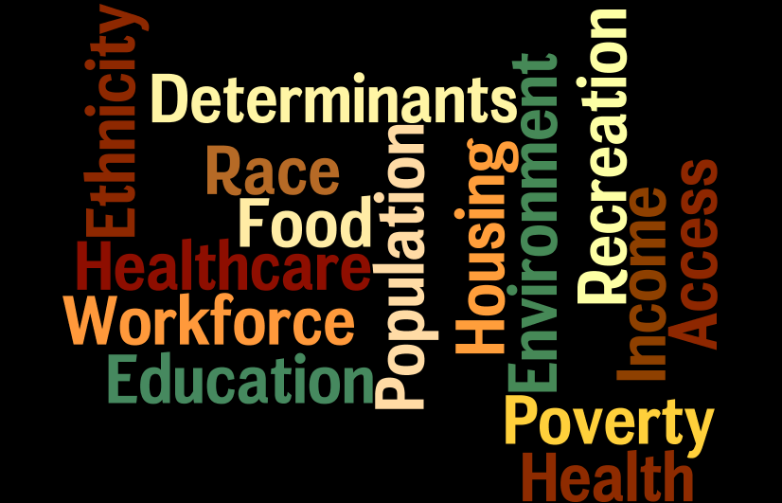
Notes:
By 2030, the majority of workers under age 25 will be people of color. And by 2042, the majority overall will be people of color.
Of the total wealth generated between 1983 and 2009, 82 percent of it went to the wealthiest 5 percent of households while the typical household’s wealth actually declined.15 The median wealth of white households is now 20 times that of black households and 18 times that of Latino households—the largest gaps since the federal government began tracking these data 25 years ago.
The jobs of the future will require ever-higher levels of skills. The Center for Education and the Workforce at Georgetown University projects that 45 percent of jobs in 2018 will require higher education—at least an associate’s degree. But there are wide racial disparities in higher education attainment: While 43 percent of working-age whites have at
least an associate’s degree, this is true for only 27 percent of African Americans, 26 percent of U.S.- born Latinos, and 14 percent of Latino immigrants. Disparities in gaining the education needed to get these better jobs begin long before college. Lowincome children of color often attend the worst schools and lack the quality teachers, curricula, classrooms, and extracurricular supports that help middle-class children succeed. By the fourth grade, 83 percent of poor children fail to reach proficiency in reading, and 78 percent are not proficient in math. Rates are even worse for poor children who are African American, Latino, or Native American. High-school dropout remains a serious challenge: Six of every 10 black, Latino, and Native American high-school students graduate, compared to eight in 10 white students.
America’s Tomorrow: Equity is the Superior Growth Model; Treuhaft, Blackwell, Pastor (2011)

Slide 6
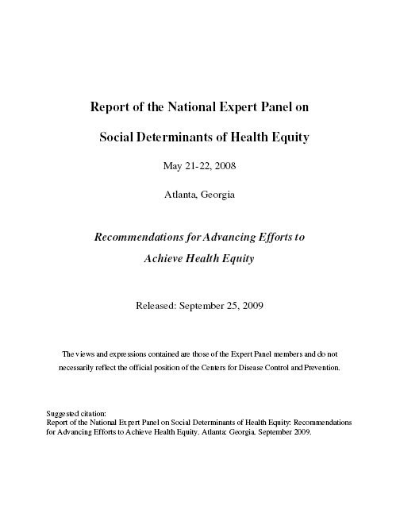
Who has heard of the CDC Expert Panel on the Social Determinants of Health Equity?
Notes:
Released in 2009 (yes, it is dated in 2008).

Slide 7
Background
2008
NACDD and CDC convene the Expert Panel
2009
Expert Panel report released
2010
HEC reviews report
2011
Recommends actions to NACDD
2012
HEC maps NACDD council’s health equity activities

Slide 8
Process
Design
Recruit
Distribute
Interview
Analyze, synthesize
Notes:
Designed an interview questionnaire and a process to administer
Recruited an intern from Emory University
Distributed interview questions in advance plus links to two national movements to achieve health equity
Conducted telephone interviews with each council chair and consultant
Reviewed all interviews for consistent themes and recommendations

Slide 9
Who was interviewed by Samantha Campillo?

Slide 10
Preliminary Findings
Communication for common understanding of the role and activities
Strategic plans and daily activities.
More collaboration and participation
Notes:
More communication is essential to creating a common understanding of the role and activities of Board and other councils, including the Health Equity Council. Health equity needs to be more apparent in the Association and individual council’s strategic plans and daily activities. For example, councils can add health equity language to their goals and objectives; NACDD can add health equity into job descriptions or create internal guides and policies that focus the Association on health equity. Interviewees expressed support for more collaboration and participation with the Health Equity Council, provided collaboration goals are clearly defined.
Councils can add health equity language to their goals and objectives
Councils want to learn the role and activities of the Board and other councils, including the Health Equity Council
While councils consider health equity a priority, they disagree about articulating it as a specific priority or embed in all work

Slide 11
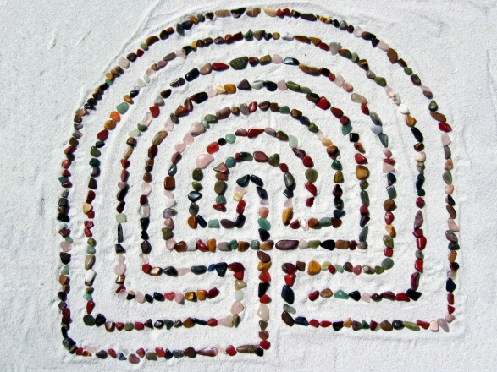
Preliminary Findings
Well supported network of people
Disseminating promising practices and success stories
Awareness of the link between health disparities and health equity, and chronic disease
Notes:
The Association membership is a well supported network of people working in chronic disease who are ready to connect with each other and with other organizations to achieve health equity. They can enhance this support by disseminating promising practices and success stories related to health equity. The Health Equity Council can support councils by providing definitions for health equity and related concepts, and by providing examples of activities that advance health equity. The Association and the Council can strengthen other council member’s awareness of the link between health disparities and health equity, and chronic disease.

Slide 12
Preliminary Findings
A majority of councils consider health equity a high priority
Specific priority vs. embedded or assumed in all work.
However, most councils do not work directly with health equity data.
Notes:
A majority of councils consider health equity a high priority or think it should be a high priority. However, interviewees disagreed about whether to articulate health equity as a specific priority, or if health equity should be embedded or assumed in all work. However, most councils do not work directly with health equity data.

Slide 13
Recommendations
The Association could:
Promote networking
Connect to resources
Disseminate information and best practices
Strengthen member awareness
Add health equity language to internal guides and policies
The Health Equity Council should:
Provide examples of activities that advance health equity
Clearly define goals for collaboration
Help councils apply health equity and social determinant data
Notes:
NACDD has the ability to reach and connect chronic disease programs and supports states very well.
Promote networking
Connect councils to other organizations and resources
Disseminate state information and best practices
Strengthen member awareness of link between health disparities and chronic diseases
Add health equity language to goals & objectives, job descriptions and internal guides and policies
Awareness and leadership development are core to the National Stakeholder Strategy for Achieving Health Equity. These are areas where NACDD has a clear opportunity to contribute to achievement of this National Plan. The HEC looks forward to supporting NACDD’s leadership in this.

Slide 14
Notes:
Prevention Institute
PolicyLink – America's Tomorrow

Slide 15
Next Steps
Finalize and recommend
Dialogue
Health Equity Objectives
Notes:
Finalize analysis and make recommendations to the Board
Continue to dialog with councils to identify health equity related projects
Draft and present to NACDD evaluation staff objective(s) for which councils and NACDD can begin to measure impact on health equity.

Slide 16
Name some national effort to achieve health equity with which we should align?

Slide 17
What is something you learned today that you plan to act on?
What is something you heard you want more information about?

Slide 18
Contact Us
For more information contact Kati Moseley or Gail Brandt:
katarina.moseley@state.or.us
gbrandt@chronicdisease.org
Or visit: www.chronicdisease.org

