Slide 1
Healthy Students are Better Learners
Eileen Hare, DPI
Jon Morgan, DHS

Slide 2
Whole School, Whole Community, Whole Child
Healthy students are better learners and
Schools are the right place to start
Health and Wellbeing
Notes:
Healthy Students Are Better Learners
Health-related factors such as hunger, physical and emotional abuse, and chronic illness can lead to poor school performance.¹ Health-risk behaviors such as early sexual initiation, violence, unhealthy eating, and physical inactivity are consistently linked to poor grades, test scores, and lower educational attainment.²⁻⁵
Leading national education organizations recognize the close relationship between health and education, as well as the need to foster health and well-being within the educational environment for all students.⁶⁻⁹
Schools are the Right Place for a Healthy Start
Scientific reviews have documented that school health programs can have positive effects on academic outcomes, as well as health-risk behaviors and health outcomes.¹⁰⁻¹¹ Similarly, programs that are primarily designed to improve academic achievement are increasingly recognized as important public health interventions.¹²⁻¹³
Schools play a critical role in promoting the health and safety of young people and helping them establish lifelong healthy behaviors. Research also has shown that school health programs can reduce the prevalence of health-risk behaviors among young people and have a positive effect on academic achievement. CDC analyzes research findings to develop guidelines and strategies for schools to address health-risk behaviors among students and creates tools to help schools implement these guidelines.

Slide 3

Whole School, Whole Community, Whole Child Model (WSCC) – a collaborative approach to learning and health
  ASCD: www.ascd.org/learningandhealth
  CDC: www.cdc.gov/HealthyYouth/cshp/
Notes:
WSCC Model launched March 2014 by ASCD & CDC.

Slide 4

Special Education
After-school Programs
Pregnancy Prevention
Clinic
HIV/STD
Prevention
Physical Education
Health Services
Psychological Testing
Health Education
Crime Prevention
Pupil Services
Immunizations
Juvenile Courts
Drug Prevention
Nutrition Education
School Safety
Mental Health Services
School Food Services
Environmental Health
Drug Services
Counseling
Social Services
Community Organizations
Smoking Cessations
Staff Wellness
Child Protective Services
An Example of a Typical School

Slide 5
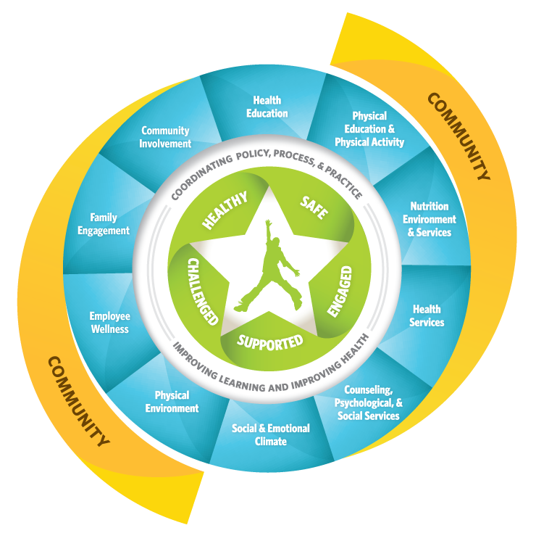
Notes:
Whole School, Whole Community, Whole Child
The Whole School, Whole Community, Whole Child (WSCC) model combines and builds on elements of the traditional coordinated school health approach and the whole child framework by
Responding to the call for greater alignment, integration, and collaboration between education and health to improve each child's cognitive, physical, social, and emotional development.
Incorporating the components of a coordinated school health program around the tenets of a whole child approach to education.
Providing a framework to address the symbiotic relationship between learning and health.
The focus of the WSCC model is an ecological approach that is directed at the whole school, with the school in turn drawing its resources and influences from the whole community and serving to address the needs of the whole child. ASCD and the U.S. Centers for Disease Control and Prevention (CDC) encourage use of the model as a framework for improving students' learning and health in our nation's schools.

Slide 6
issue
No matter how well teachers are prepared to teach,
no matter what accountability measures are put in place,
no matter what governing structures are established for schools, educational progress will be profoundly limited if students
are not motivated and able to learn.
- Charles Basch
Notes:
Health and wellbeing have, for too long, been put in a silo—both logistically and philosophically— apart from education and learning. Charles Basch in his meta-analysis Healthier Students Are Better Learners called for a renewed focus on health as the missing link in school reforms to close the achievement gap.
No matter how well teachers are prepared to teach, no matter what accountability measures are
put in place, no matter what governing structures are established for schools, educational progress will be profoundly limited if students are not motivated and able to learn.

Slide 7


Success in School is
More Than Just Academics
Schools must also consider other factors that affect
academic achievement:
  Healthy Food
  Options
  Opportunities To Be
  Physically Active
  Healthy Food
  Options
Notes:
NARRATIVE
It boils down to the fact that students’ success in schools is more than just academics. Evidence indicates that education and health for students must go hand-in-hand in order for students to succeed.^{2,3} In addition to making sure students are learning, there are school health policies and practices that affect academic achievement that need to be in place such as offering healthy food options and providing opportunities for students to be physically active.

Slide 8

Academic Achievement
Academic performance
  Class grades
  Standardized tests
  Graduation rates
Education behavior
  Attendance
  Drop out rates
  Behavioral problems at school
Students’ cognitive skills and attitudes
  Concentration
  Memory
  Mood
Notes:
NARRATIVE
Let’s first define academic achievement. There are three aspects of academic achievement — academic performance, education behavior, and students’ cognitive skills and attitudes.⁶
As shown on the slide,
academic performance includes class grades, standardized tests, and graduation rates;
education behavior includes attendance, dropout rates, and behavioral problems at schools; and
finally, students’ cognitive skills and attitudes include concentration, memory, and mood.

Slide 9
Healthy Eating and Academic Achievement
Dietary Behavior/Issue | Related Academic Achievement Outcomes
Participation in the School Breakfast Program (SBP) | Increased academic grades and standardized test scores Reduced absenteeism Improved cognitive performance
Skipping breakfast | Decreased cognitive performance
Lack of adequate consumption of specific foods | Lower grades
Deficits in specific nutrients | Lower grades Higher rates of absenteeism and tardiness
Insufficient food intake | Lower grades Higher rates of absenteeism Repeating a grade Inability to focus
Notes:
NARRATIVE
Evidence has shown that specific dietary practices and issues are related to different aspects of academic achievement. Specifically:
Student participation in the USDA School Breakfast Program (SBP) is associated with increased academic grades and standardized test scores, reduced absenteeism, and improved cognitive function (e.g., memory).⁷⁻¹⁴
Skipping breakfast is associated with decreased cognitive performance (e.g., alertness, attention, memory, processing of complex visual display, and problem solving) among students.^{10,11,13,15-20}
Lack of adequate consumption of specific foods, such as fruits, vegetables, or dairy products, is associated with lower grades among students.²¹⁻²³
Deficits of specific nutrients (i.e., vitamins A, B6, B12, C, folate, iron, zinc, and calcium) are associated with lower grades and higher rates of absenteeism and tardiness among students.^{3,7,12}
Hunger due to insufficient food intake is associated with lower grades, higher rates of absenteeism, repeating a grade, and an inability to focus among students.^{7,12,22-26}
CDC and many national organizations recommend establishing a healthy school nutrition environment to support both student health and learning. A healthy school nutrition environment includes:
access to healthy and appealing foods and beverages available to students in school meals, vending machines, school stores, à la carte lines in the cafeteria, fundraisers, and classroom parties;
consistent messages about food and healthy eating across the school environment and school curricula; and
opportunities for students to learn about healthy eating through health education.²⁷

Slide 10

Wisconsin High School Survey
Percentage of students who drank a can, bottle, or glass of soda or pop one or more times per day during the past seven days
Q77 - Weighted Data
*Non-Hispanic.

Slide 11
Nutrition Strategies
Federal Child Nutrition Programs
  National School Lunch Program
  School Breakfast Program
  Summer Food Service Program
  Fresh Fruit and Vegetable Program
  Special Milk Program
Offer these programs in your district
Encourage student participation in these programs
Notes:
Children and adolescents who do not consume food and beverages that provide adequate energy and nutrients are at risk for poor outcomes including poor academic achievement , development of psychosocial difficulties, and increased likelihood of developing chronic diseases.
The USDA Food and Nutrition Service administers several child nutrition programs including the National School Lunch Program, the School Breakfast Program, the Summer Food Service Program, the Fresh Fruit and Vegetable Program, and the Special Milk Program.
Each of these programs helps to fight hunger and obesity by providing healthy meals and snacks to children.
Advocate for your students and take advantage of offering these programs in your district.
In addition, encourage student participation in these programs.
One proven method to increase participation in school breakfast program is to make it part of the school day. Innovative models such as breakfast in the classroom, second chance breakfast, and grab-n-go breakfast have show to significantly boost school breakfast participation.

Slide 12
Nutrition Strategies
Nutrition Education
  School-based nutrition education has the potential to impact the health and dietary behaviors of children
  Ensure success of classroom nutrition education by providing educators with training, resources, and time to teach
School Gardens
  School gardens may positively impact children’s food choices by improving their preferences for vegetables and increasing their nutrition knowledge
For available nutrition education resources: http://ne.dpi.wi.gov/ne_nutred
Notes:
School-based nutrition education has the potential to impact the health and dietary behaviors of children.
Yet, a report from the National Center for Education Statistics found that while 88 percent of elementary school teachers reported teaching nutrition in the classroom, not nearly enough time was devoted to nutrition education during the year. The mean number of hours spent on nutrition instruction was 13, well below the 50 hours thought to be necessary for impact on behavior.
Ensure success of classroom nutrition education by providing educators with training, resources, and time to teach.
Another great way to incorporate nutrition education in the school day is through school gardens.
Recent research has documented that involving children in gardening is a promising strategy for increasing fruit and vegetable consumption. In addition, school gardens may positively impact children’s food choices by improving their preferences for vegetables and increasing their nutrition knowledge.
There are ready to go resources for general nutrition education and garden based education available on the Wisconsin Team Nutrition website.
By making the connection that that well-nourished students learn better, we move beyond merely teaching the food groups and instead teach more comprehensive nutrition education.

Slide 13
Nutrition Strategies
Smarter Lunchrooms
  Evidenced-based strategies that can be used to improve student eating behaviors
Smarter Lunchroom strategies seek to:
  Nudge students to unknowingly make healthier choices in the lunchroom
  Increase sales by implementing innovative strategies that encourage student consumption of healthier foods
  Implement low-cost/no-cost strategies that focus on changing the school lunchroom environment
  Keep a variety of food choices without completely eliminating unhealthy food choices from the menu
Food service staff can use these inexpensive strategies to create cafeterias that promote healthy foods
For more information: http://smarterlunchrooms.org/
Notes:
To further improve the school nutrition environment, implement smarter lunchroom strategies in the cafeteria. These evidence-based strategies can be used to improve child eating behaviors and thus improve the health of children.
Specifically smarter lunchroom strategies seek to:
Nudge students to unknowingly make smarter, healthier choices in the lunchroom.
Increase sales by implementing innovative strategies that encourage student consumption of healthier foods.
Implement low-cost/no-cost strategies that focus on changing the school lunchroom environment.
Keep a variety of food choices without completely eliminating unhealthy food choices from the menu or only raising prices of less healthy food
Food service staff can use these inexpensive strategies to create cafeteria environments that promote healthy foods, thereby influencing students to select healthier lunch options.
For more information on the strategies please visit: http://smarterlunchrooms.org/.

Slide 14
Physical Activity and
Academic Achievement
Physical Activity Practice | Related Academic Achievement Outcomes
Students who are physically active | Have better grades, better school attendance, and better classroom behaviors
Higher physical activity and physical fitness levels | Improved cognitive performance
More participation in physical education class | Better grades, standardized test scores, and classroom behavior
Time spent in recess | Improved cognitive performance and classroom behaviors
Participation in brief classroom physical activity breaks | Improved cognitive performance, classroom behaviors, and education outcomes
Participation in extracurricular physical activities | Higher GPAs, lower drop-out rates, and fewer disciplinary problems
Notes:
NARRATIVE
Taking a closer look at the evidence, specific physical activity practices are linked to different aspects of academic achievement.
Students who are physically active tend to have better grades, school attendance, cognitive performance (e.g., memory), and classroom behaviors (e.g., on-task behavior).²⁸⁻³⁴
Higher physical activity and physical fitness levels are associated with improved cognitive performance (e.g., concentration and memory) among students.³⁴⁻³⁹
More participation in physical education class has been associated with better grades, standardized test scores, and classroom behavior (e.g., on-task behavior) among students.⁴⁰⁻⁴³
Time spent in recess has been shown to positively affect students’ cognitive performance (e.g., attention, concentration) and classroom behaviors (e.g., not misbehaving).⁴⁴⁻⁴⁸
Brief classroom physical activity breaks (i.e., 5-10 minutes) are associated with improved cognitive performance (e.g., attention and concentration), classroom behavior (e.g., on-task behavior), and educational outcomes (e.g., standardized test scores, reading literacy scores, math fluency scores) among students.^{32,49-54}
Participation in extracurricular physical activities such as interscholastic sports has been associated with higher GPAs, lower drop-out rates, and fewer disciplinary problems among students.⁵⁵⁻⁶⁷
CDC and many national organizations recommend a comprehensive, school-wide approach to physical activity that provides opportunities for students to be physically active throughout the school day and after school.⁶⁸ This comprehensive approach provides a variety of physical activities to help all students attain at least 60 minutes of physical activity each day.⁶⁸
Notes to Facilitator:
For this presentation, the term physical activity includes physical education. Physical activity is any bodily movement that is produced by skeletal muscle and that substantially increase energy expenditure; whereas physical education provides students with the knowledge and skills necessary to perform a variety of physical activities, maintain physical fitness, and to value and enjoy physical activity as part of a healthy lifestyle. Physical education includes curriculum, instruction, and assessment that is sequential from pre-kindergarten through high school.

Slide 15

Wisconsin High School Survey
Percentage of students who were physically active for a total of at least 60 minutes per day on five or more of the past seven days
Q80 - Weighted Data
*Non-Hispanic.

Slide 16
What is the Problem?
The 2013 Wisconsin Youth Risk Behavior Survey indicates that among high school students:
Physical Inactivity
13% did not participate in at least 60 minutes of physical activity on at least 1 day. (3)
48% did not attend physical education classes on 1 or more days in an average week when they were in school.
22% watched television 3 or more hours per day on an average school day.
34% used computers 3 or more hours per day on an average school day. (4)
— did not play on at least one sports team run by their school or community groups during the 12 months before the survey.

Slide 17
Physical Activity Strategies
Key concepts
Available resources
Creating the greatest impact
Related initiatives

Slide 18

WI DPI PE Home (http://sspw.dpi.wi.gov/sspw_physicaled)
Notes:
All strategies on Web page

Slide 19


Three Key Concepts
Goal
Get at least 60 minutes of physical activity: DYGY60?
Did You Get Your 60?
Utilize five key strategies that are relatively low resource:
  Active Schools: Core 4+
Pick strategies that have the greatest impact:
Impact = Reach x Dose
(more on this later)
How to get to the goal

Slide 20
Active Schools: Core 4+

Slide 21
Comparison Active Schools Core 4+, Let’s Move and CDC School PA Program
Active Schools: Core 4+ | Let’s Move, Active Schools | CDC Comprehensive School PA Programs
1. Active PE Class Time | 1. Build PE Programs | 1. Quality Physical Education
2. Active Classrooms | 2. Classroom PA | 2. Physical Activity During School
3. Active Recess or Open Gym | 3. Before & After School Physical Activity | 3. Before & After School Physical Activity
4. Before & After School Physical Activity | 4. Staff Involvement | 4. Staff Involvement
+ Family and Community Physical Activity | 5. Family & Community Engagement | 5. Family & Community Engagement
Similar focus. Core 4+ focuses on five specific strategies.
Let’s Move Schools looks at two specific strategies plus broader issues and uses the CSPAP framework, which was developed with AAHPERD.

Slide 22
Active Schools: Core 4+ Strategies
Active Schools: Core 4+ is a set of strategies to increase student physical activity.
1. Learn what Core 4+ could mean for your school!
2. How "Did You Get Your 60?"
3. Active Schools: Core 4+ Learn. Do. Share
4. CDC resources
Active Schools: Core 4+ Overview Video

Slide 23



Active Schools: core 4+ Intro

Slide 24
5 strategies
1. Active PE Minutes Video
2. Active Classrooms Video
3. Active Recess/Open Gym Video
4. Before and After School Video
+. Home and Community Video

Slide 25
Change the Environment to Increase Physical Activity
Active Classrooms: % Schools Participating
Survey: 3 projects since 2010
Each project has:
Showed a significant increase in participation pre - post
Started at a higher % than the previous project – it’s “catching on”
Note: New accelerometer pilot will look at real changes in activity levels

Slide 26
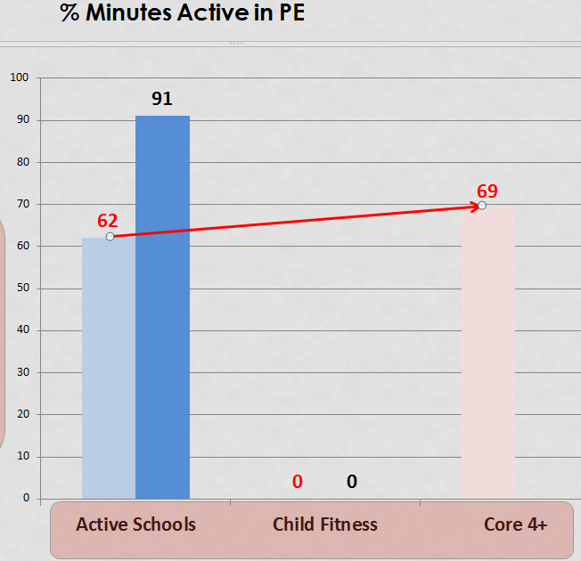
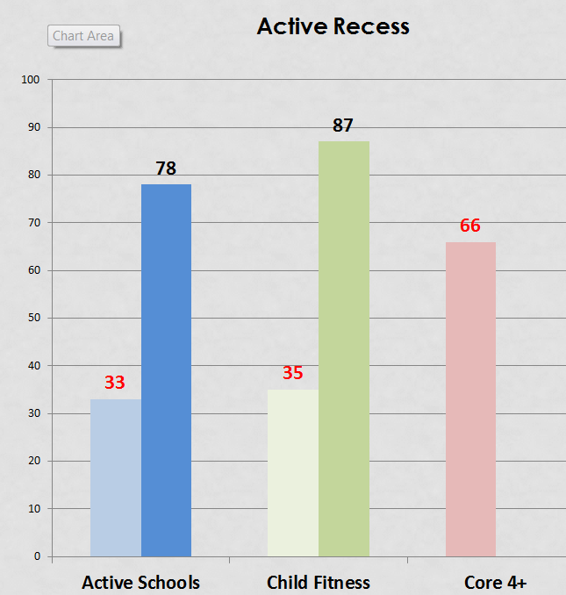
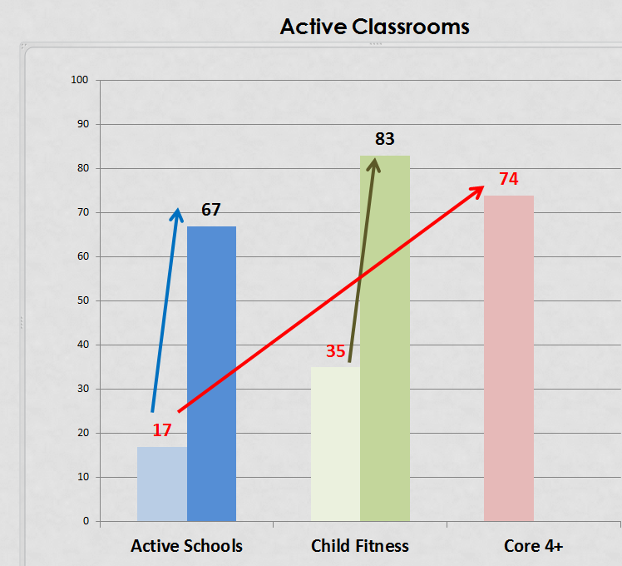
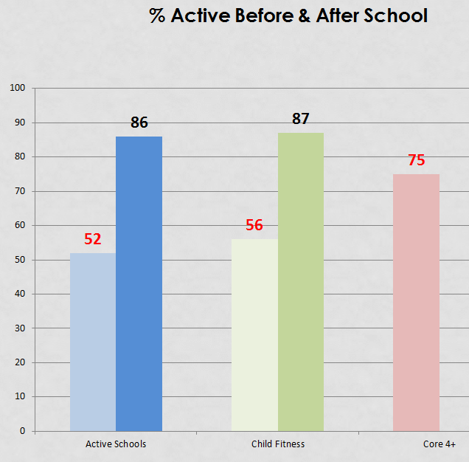
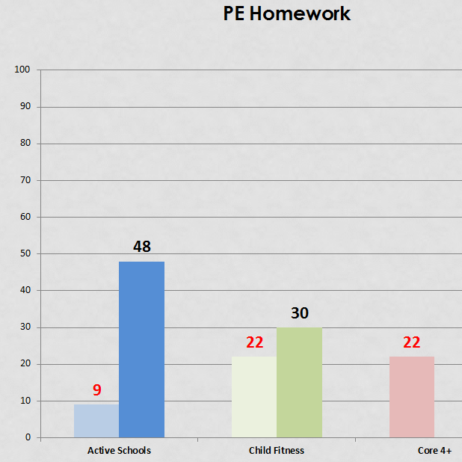
Why Active Schools: Core 4+
The trend for Active Classrooms also showed up in the other strategies

Slide 27

How best to increase physical activity?
Do the math!
Think in terms of impact using the formula:
IMPACT = REACH x DOSE
Dose is how much of a given strategy is occurring i.e. minutes of activity
Reach is what percent of the targeted population is being affected.

Slide 28

Delivering some “dose”
One Example in a school of 100 kids
Use 1 dose of activity is equal to 10 minutes. Child goal is 60 minutes per day or 6 doses.
Scenario 1 – School with 100 students holds a 1-day event where kids walk for 30 minutes.
All kids participate so impact is 3 doses x 100% = 300 (for the year)
Scenario 2 – School institutes a new policy that requires daily “active classrooms” where there is 5 minutes of activity in the morning & 5 minutes in the afternoon.
All kids participate, so impact is 1 dose/day x 100% of the kids = 100 x 180 school days = 18,000 (for the year)
300
18,000

Slide 29
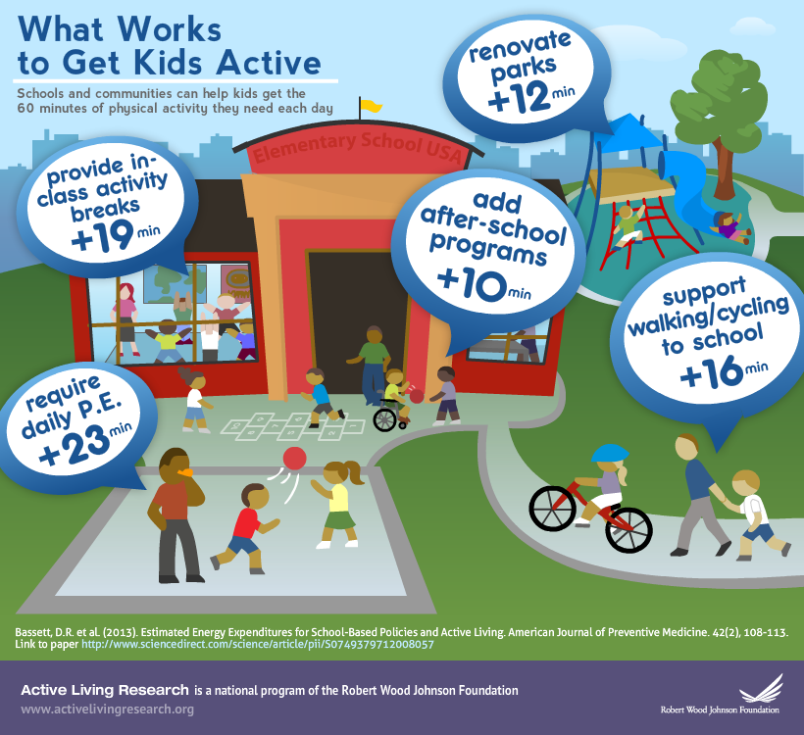
Study: All Five Strategies – Average ⬆ in Activity
Active PE Minutes = 6 minutes
Active Classrooms = 19 minutes
Active Recess = 5 minutes
Before and After School = 10 minutes
Family and Community: walk to school = 16 minutes
56 minutes
The 56 minute total is a little misleading because it only counts those kids who are participating in each strategy. The active school survey distributes the minutes across all students.
Ex: walk to school is 16 minutes, but if only 25% of all the students walk, it’s averages only 4 mins./student
In what order would you list these strategies in terms of most effective?
David R. Bassett, et. al., Estimated Energy Expenditures for School-Based Policies and Active Living, American Journal of Preventive Medicine, Volume 44, Issue 2, February 2013, Pages 108-113

Slide 30
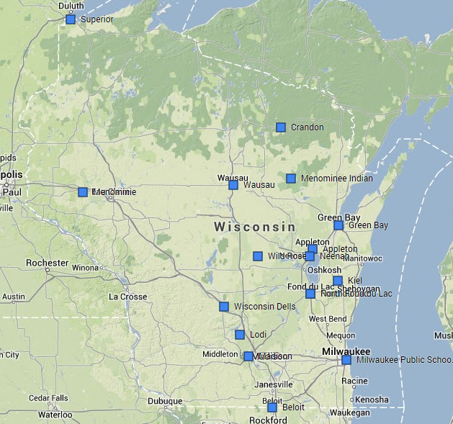
Deeper Dive
  375 schools (186,494 students),
~130 schools tracking (78,588 students)
16 Priority Districts
    LMAS
School Districts (16)
Appleton
Beloit
Crandon
Fond du Lac
Green Bay
Kiel
Lodi
Madison
Menominee Indian
Menomonie
Milwaukee Public Schools
Neenah
North Fond du Lac
Superior
Wausau
Wisconsin Dells

Slide 31
Total Activity Minutes
(early Survey results)
Strategy | Study Minutes | Core 4+ Minutes
Active PE Minutes | 6* | 14
Active Classrooms | 19# | 4
Active Recess/Open Gym | 5 | 14
Before & After School | 10 | 14
Family/Community (Walk to School) | 16# | 3 (+3 homework)
Total | 56 | 52
* Additional minutes # Only for those participating
Not all strategies are equal and not all minutes are the same.
Goal is at least 60 minutes
Range = 9 minutes to 145 minutes!

Slide 32
All Schools Total Activity Minutes
DYGY60? – How you get to 60 minutes of activity per day doesn’t matter!
Strategy / Average daily minutes per student per day | Elem. (76) | Middle (15) | HS (26) | All (117)
Active PE Minutes | 9 | 14 | 31 | 14
Active Classrooms * | 6 | 1 | 3 | 4
Active Recess/Open Gym | 17 | 5 | 8 | 14
Before & After School | 7 | 22 | 29 | 14
Family/Community * (Walk to School/PE Homework) | 6 | 8 | 5 | 6
Total | ~ 45 | ~ 50 | ~ 75 | ~ 52
* Underutilized: <50% of schools/classes 117 Active Schools pre-survey estimates

Slide 33
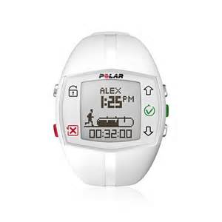
Activity Pilot
Data: surveys, 3-two week interval
  Urban, Suburban, Rural
    (Beloit, Appleton, Lodi)
  Implement 3 strategies
    Active PE/Quality Physical Education
    Active Classrooms/PA During School and Staff Involvement
    Active Recess or Open Gym/PA During School and Staff Involvement
Regional train the trainer sessions

Slide 34
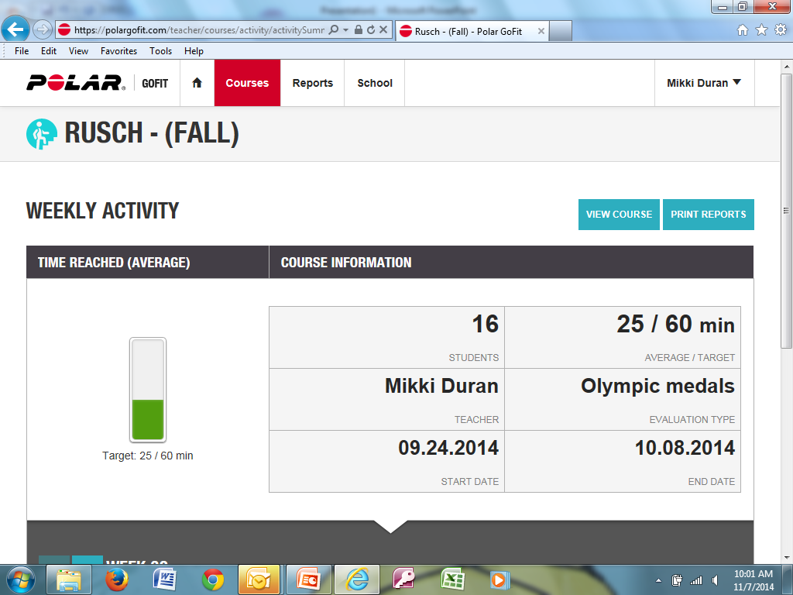

Slide 35
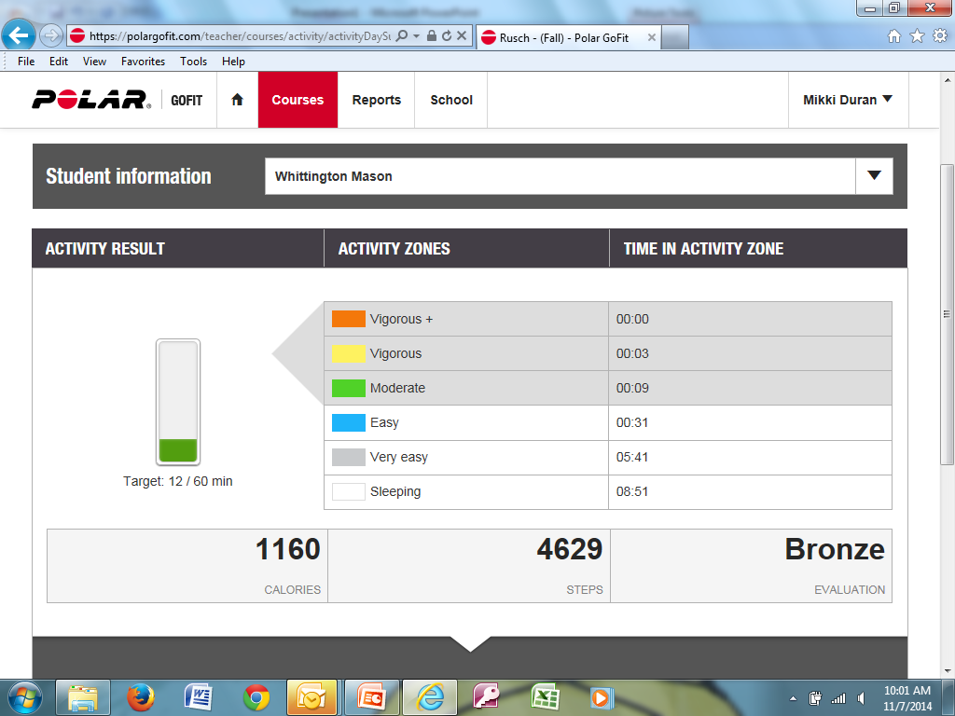

Slide 36
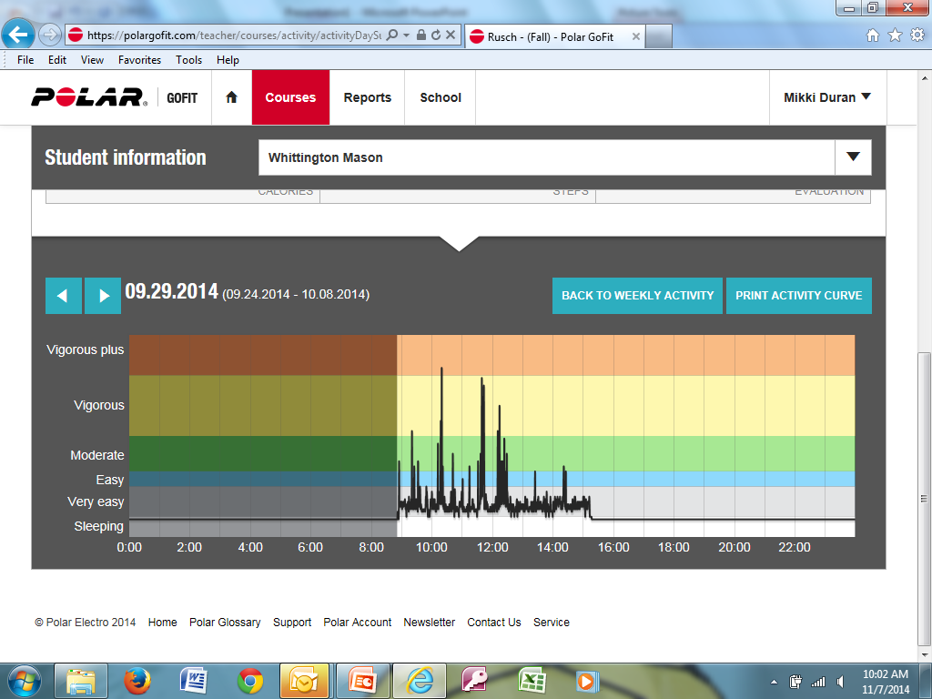

Slide 37
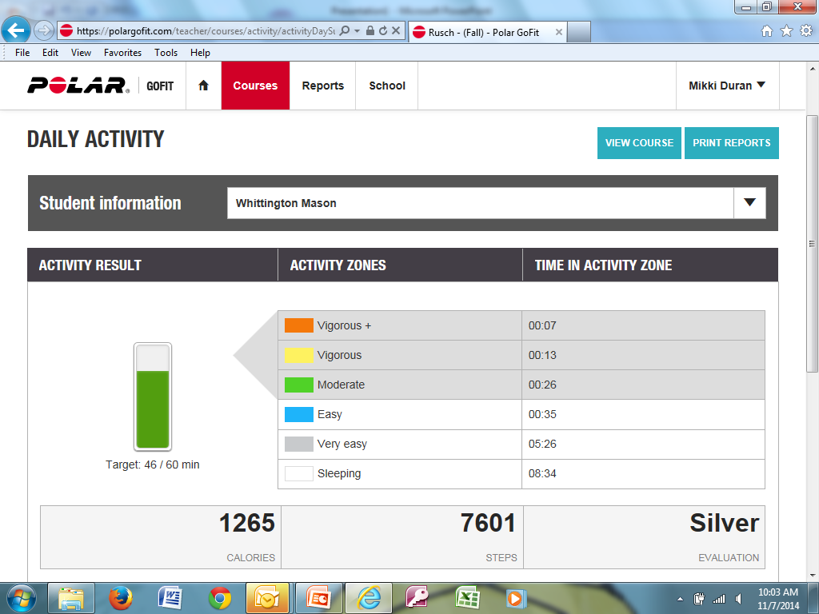

Slide 38
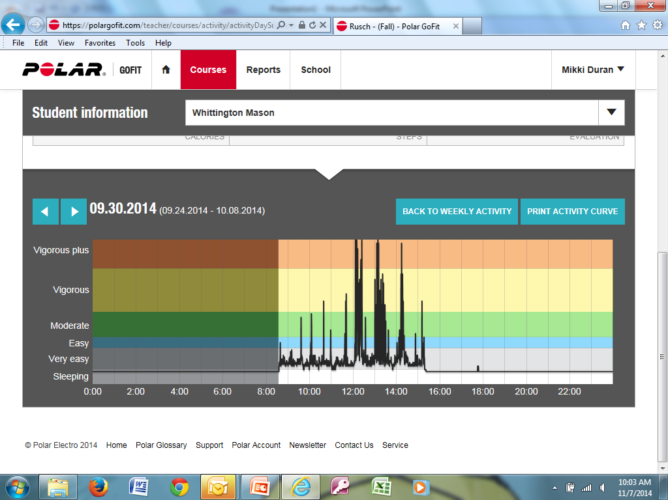

Slide 39
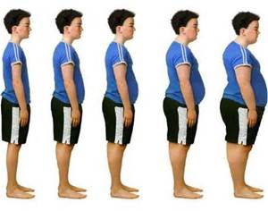
What is the Goal?
Every student – Every day! Healthier Kids Learn Better!
Promoting Excellence For All
Increase Physical Activity –Reverse the obesity trend

Slide 40
Funded Projects
Driven to Better Health
Wisconsin School Health Award

Slide 41
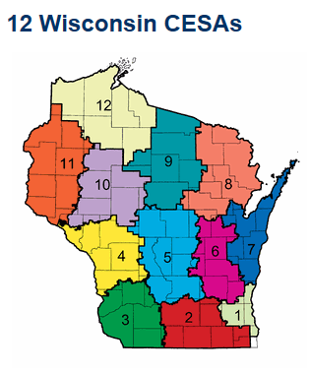
CSPAP/ASC4+
Train the Trainer
5 Regional Trainers
  12 CESA (Cooperative Educational Service Agencies)
  Universities
  Implement
    Fall 2015

Slide 42


Together Let’s Narrow the Gaps
Achievement and Health

Slide 43
IDEAS?

Slide 44
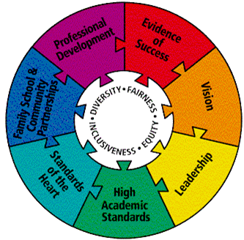
School Improvement Plan
Allows continuous planning
AHG is research-evidenced based
Comprehensive online data
Work plan is easily editable and shared

Slide 45
Educator Effectiveness/West Florence High School
Champion PE teacher – Pete Ellis
  2 schools: elementary and high school
Goal Based Evaluation in South Carolina
  Support professional growth
  Empowers teachers to direct own Professional Growth
Grew School Wellness Plan
  Staff is allowed to work on wellness as part of GBE

Slide 46

Discussion/Questions
What strategies could you implement?
First person you will discuss with once back in the district?
DPI Site for resources: http://sspw.dpi.wi.gov/sspw_physicaled

