Slide 1
OLDER AMERICANS MONTH
CDCs Healthy Aging Program
Dave Baldridge
&
Mario Garrett
Advanced Care Planning and
Emergency Preparedness
Thursday May 5th, 2011
Global Communication Center

Slide 2
Overcoming Paradigm paralysis
End of Life Care for American Indians

Slide 3

Paradigm change
Who’s an Indian elder?

Slide 4
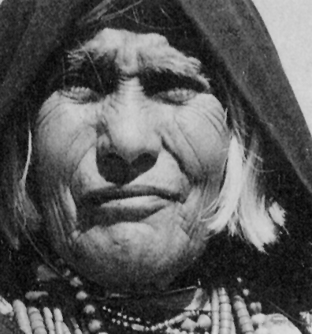
“But she won’t talk about it.”

Slide 5
Barriers to “The Talk”
Tradition
Spirituality
Historical Trauma
Distrust of Medical System

Slide 6

Demographic changes
We have met the future. It is here. It is us.

Slide 7

As a cohort . . .
Educated
We are more . . .
Computerized
Wired
Acculturated

Slide 8
Researchers have . . .
Proposed a nursing model “built on a foundation of the ancient and venerable Native culture . . . (and) values presently utilized by Native Americans.”
                -- Struthers (2003)
Found that “some tribes do not talk about terminal illness for fear that talking about (it) will cause it to happen.”
--Hepburn, 1995

Slide 9

Researchers have . . .
Observed “that Western biomedical and bioethical concepts and principles often conflicted with traditional Navajo values and ways of thinking.”
Found 86% of Navajo elders interviewed considered
advance care planning “a dangerous violation
of traditional Navajo values . . .
--Carrese and Rhodes, 1995

Slide 10
National vs. Local Interest
In 1995 . . .
Only 2 of more than 31,518 palliative care articles in 1995 substantively addressed AIANs, and . . .
70% of tribal health director survey respondents reported very high levels of interest on their medical teams
--Spirit of Eagles program, IHS Provider, May 1995

Slide 11
Four programs to watch
Ft. Defiance, AZ Home Based Care Program
Cherokee Nation Home Health Services
Zuni Home Health Care Authority
UNM Palliative Care Program

Slide 12
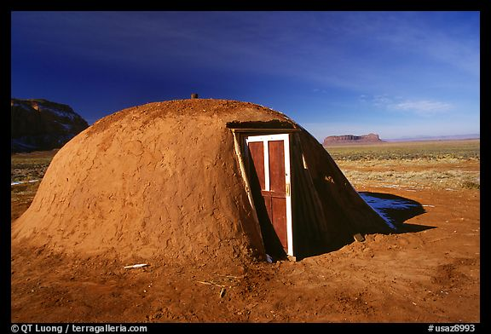
Ft. Defiance Home-Based Care Program
THE CULTURAL TEAM MODEL

Slide 13
National rates for ADs
National completion rate for advance directives—20-25%
  Mostly those with terminal illness
  or from higher socio-economic classes
  Physician compliance is poor
      Kitzes, 2003

Slide 14
Ft. Defiance: Program history
Ft. Defiance completion rate for
advance directives & DMPOAs
        1999 ADs 1%
        DMPOAs 4%
2010 ADs 85%
DMPOAs 85%

Slide 16
Ft. Defiance models
PACE
  Interdisciplinary team
Medicare Hospice Benefit
  Care focused in home, 6-month life expectancy
  Care Transitions (Eric Coleman)
  Post-hospitalization transition

Slide 17
Ft. Defiance staff
  Embedded in community
    Continuum of LTC . . . Know patients personally
    Speak language
    Cultural acceptability
    Are empathetic

Slide 18
The KEY
  “It’s all about HOW you ask the questions . . .
  and where you ask them . . .
  and when . . .
  and why.”
  Tim Domer

Slide 19
Cherokee Nation:
The “Client-Directed” model
Service Population
  160,000 families (est. 85%) Southern Baptist
  14 counties in NE Oklahoma
  7,000 sq. miles
    Staff of 220, includes 140 home health aides &
  personal care attendants

Slide 20
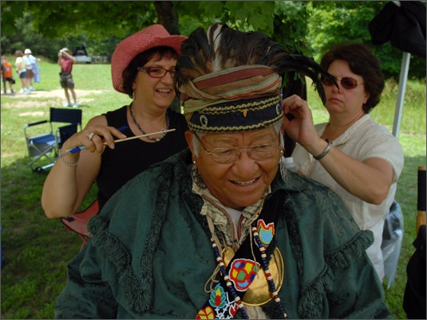
Cherokee Nation Home Health Program
THE CLIENT-DRIVEN MODEL

Slide 21
Cherokee Nation:
The “Client-Directed” model
Cherokee Nation Outreach
    Medicaid Advantage program
Cherokee Nation Home Health Services
      Tribally owned & operated
  Hospice of the Cherokees
  MC/MA certified in-home hospice

Slide 22
CNHHS: Program history
Established in 1981
        Followed consultants’ advice
Realized “We were not different”
than other programs in the state

Slide 23
CNHHS: Program history
“Caregivers were stressed out.”
Changed focus: personal care, homemaker
chore services, and extended respite care.

Slide 24
CNHHS: Program history
Available 24/7
Does not limit staff provision of
respite or other home care.

Slide 25

CNHHS: The Key
Threw all the models out
Began asking one question: “What do you need?”

Slide 26
Zuni Home Health Care Agency:
THE TRIBAL-IHS
PARTNERSHIP
MODEL

Slide 27
Zuni Home Health Care Agency:
  1,350 traditional Zuni & Navajo elders, most within 5 mi.
  Two nurses, several home health aides
  IHS hospital: 37 beds, 12 physicians,
  3 PAs, 4 nurses—24 hr. ER, home visits

Slide 28
Zuni Home Health Care Agency
The Keys
  Respect/consistency with cultural beliefs
  Incorporating EOL care into LTC continuum

Slide 29
Zuni Home Health Care Agency
First inter-disciplinary team effort for Indian Country EOL
Served 76 patients in 9 years
90% of patients now complete ADs

Slide 30
Zuni Home Health Care Agency
Most patients do not want to die at home
Success built on family members’ trust of home health care and hospital professionals.

Slide 31
UNMH Palliative Care Program
THE URBAN INSTITUTIONAL MODEL

Slide 32
UNMH Palliative Care Program
Albuquerque, pop. 500,000
470 bed hospital, only Level 1 Trauma Center in state
Highest (10.3%) AI/AN admissions of any
academic hospital in nation

Slide 33
UNMH Palliative Care Program
Patients by ethnicity
  AI/AN 10.3% (Navajo, Pueblo, Apache,
  urban)
  White 43%
  Hispanic 39%
43% of AI/AN patients die in hospital.

Slide 34
UNMH Palliative Care Program
Two-year-old Palliative Care Program
Two M.D.’s, nurse practitioner, part-time chaplain,
Arts in Medicine team, occasional Fellows in
gerontology or oncology.
High levels of expertise.

Slide 35
UNMH Palliative Care Program
“All our patients come to us in crisis,
with urgent needs.”
“We don’t worry about ADs or paperwork.
The trick is to set some Goals of Care,
then get them translated into actual care.”
--Judith Kitzes, M.D.

Slide 36
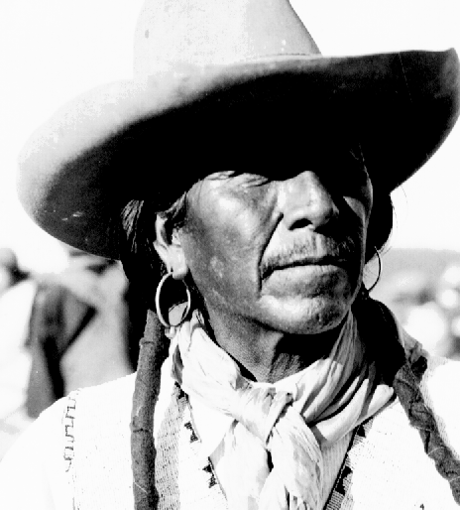
UNMH Program Results
AI/AN patient preference
for DNRs increased from
22% to 62%.
Family EOL meetings increased from
30% to 76%.

Slide 37
What they’re doing . . .
Using multi-disciplinary teams.
Consulting frequently.
Bringing no agenda,
no assumptions.

Slide 38
What they’re doing . . .
Letting patient lead!
Hiring carefully for skills & personality.
“Empathy transcends barriers.”

Slide 39
Thank you!
Dave Baldridge
<dave@nipcinfo.com> National Indian Project Center
Health Benefits ABCs
CDC Division of Healthy Aging
IHS Elder Care Initiative

Slide 40
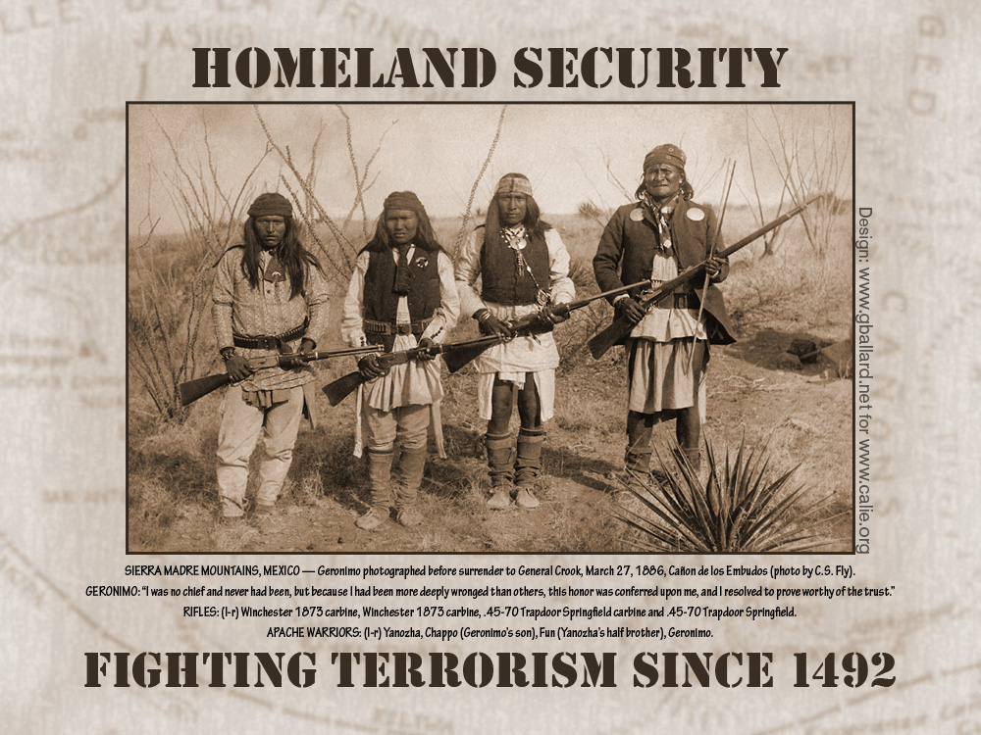

Slide 41
IHS Emergency Services
Staff function in the Office of the Director, Office of Clinical and Preventive Services
Responsibilities:
  Trauma Services
  Emergency Medical Services
  Physical Security
  Emergency Management

Slide 42
Emergency Preparedness
Outbreaks: flu epidemics, viruses, or other contagious diseases; food-borne outbreaks such as salmonella or E. coli.
Natural Disasters: earthquakes, extreme heat, floods, hurricanes, landslides and mudslides, tornadoes, tsunamis, volcanoes, wildfires, and winter weather.
Chemical / Radiation Emergency : industrial accident, or intentional such as in the case of a terrorist attack.
Mass Casualties: fires, explosions, mass transit accidents such as train crashes or bridge collapses .
Terrorism / Bioterrorism: Deliberate act of murder and destruction directed towards civilians. Deliberate release of viruses, bacteria, radiation, or other agents used to cause illness or death in people, animals, or plants. These agents can be spread through the air, water, contact, or in food.

Slide 43
Examples of published outbreaks among American Indians
1982-1991 Community-acquired invasive group A strep infections in Zuni Indians
1991 Outbreak of gastroenteritis in Galena, Alaska
1993 Four Corners hantavirus outbreak
2001 Tuberculosis outbreak on an American Indian reservation, Montana
2009 Syphilis Outbreak among American Indians — Arizona

Slide 44
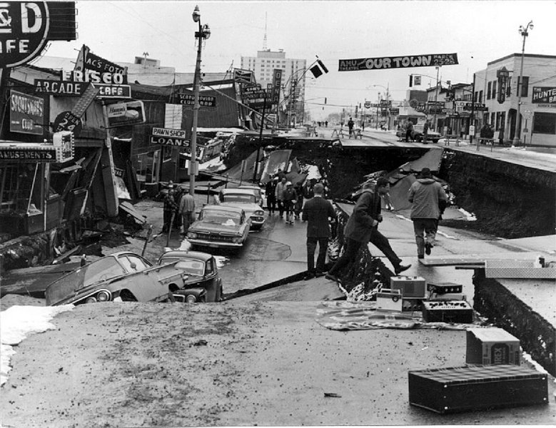
Natural Disasters
1964
Anchorage AK, 9.2 Earthquake, 131 die the most violent earthquake in US history

Slide 45
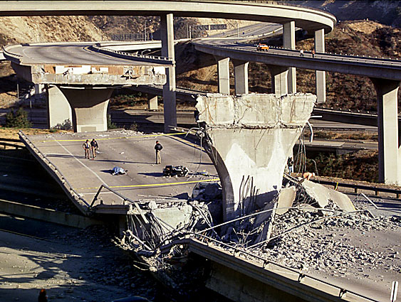
Natural Disasters
1994,
Northridge CA, 6.7 earthquake, 57 die

Slide 46

Research Priorities in Emergency Preparedness and Response for Public Health Systems
The Institute of Medicine (IOM) at the request of CDC’s Coordinating Officer for Terrorism Preparedness and Emergency Response (COTPER)
Four top-priority research areas:
enhancing the usefulness of training;
improving timely emergency communications;
creating /maintaining sustainable response systems; and
generating effectiveness criteria and metrics.

Slide 47
CDC Priorities
To Enhance:
Surveillance and Epidemiology
Preparedness and Response
Information Technology
Laboratory Capacity
and
Stockpile of Vaccines and Antibiotics
  (Strategic National Stockpile - SNS)

Slide 48
PHS Rapid Response Team
PH Nurses
Epidemiologists
Public Health Laboratorians
Emergency Medical Staff
County Veterinarian
Rapid Response Team (RRT) focuses on early detection of and rapid response to unusual disease occurrence; outbreaks or clusters of acute communicable disease, rare or unusual diseases of unknown etiology, or suspected BT.

Slide 49
CDC Expert Panel on Evaluation of
Surveillance Systems
Dan Sosin, M.D., M.P.H.
CDC/ Division of Public Health
Surveillance and Informatics
Epidemiology Program Office
Claire Broome, M.D.
CDC/ Office of the Director
James W. Buehler, M.D.
Center for Public Health Preparedness
& Research, Dept of Epidemiology
Rollins School of Public Health,
Emory University
Louise Gresham, Ph.D., M.P.H.
San Diego Health and Human Services,
Public Health Services et al.

Slide 50
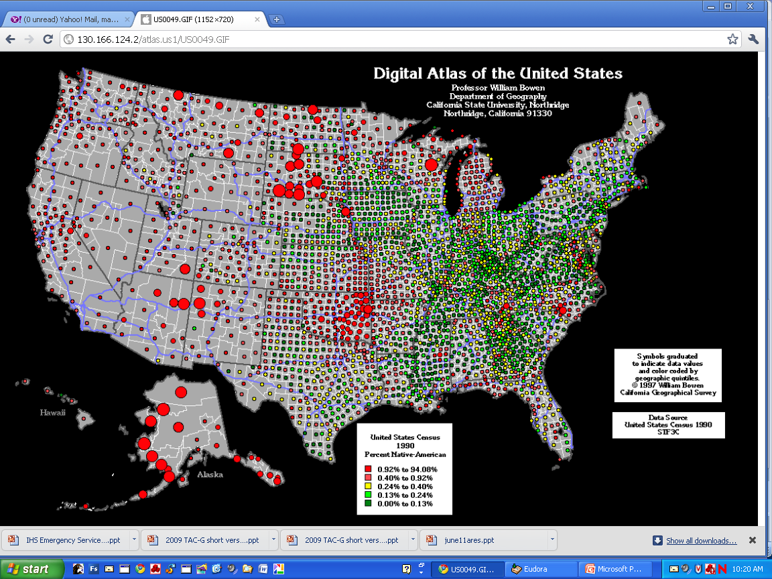

Slide 51
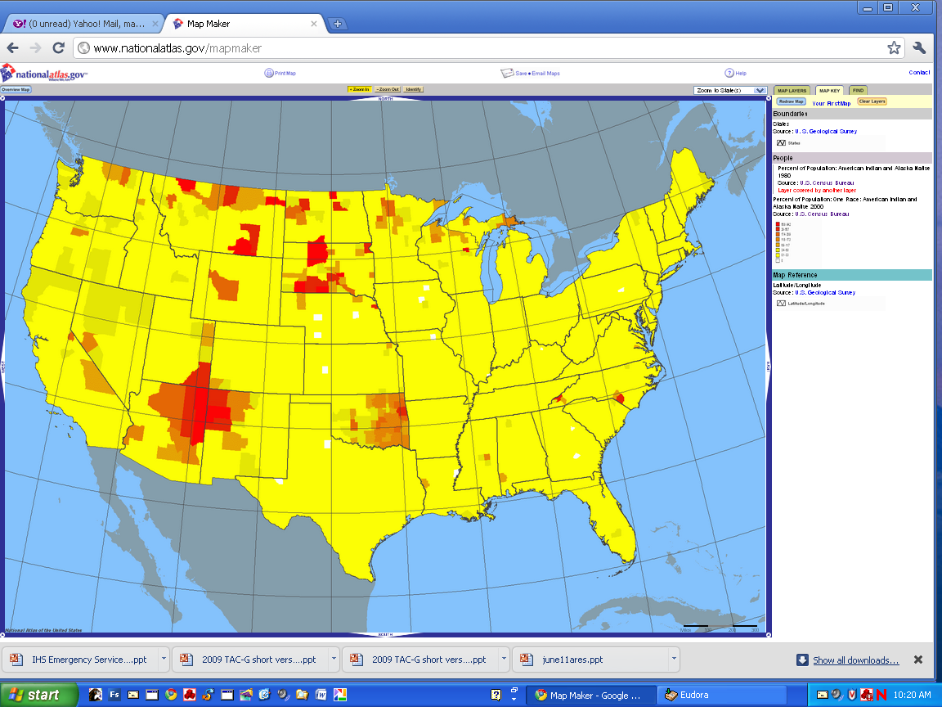

Slide 52
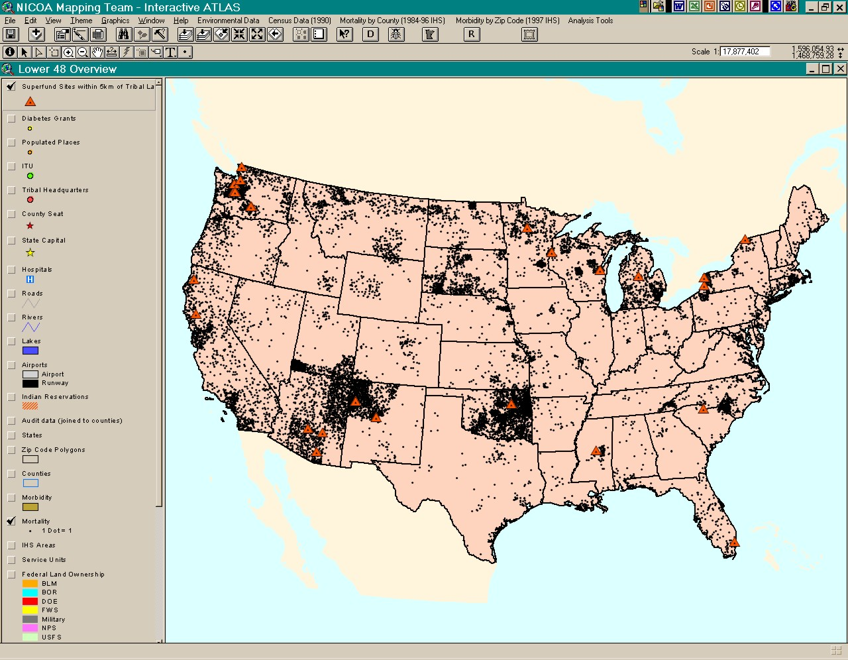

Slide 53
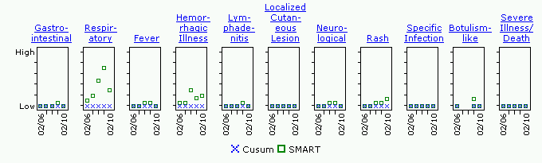
BioSense Home Page
Syndrome Specific SMART Score Results
SMART Score
Results
For Specified
Syndrome

Slide 54
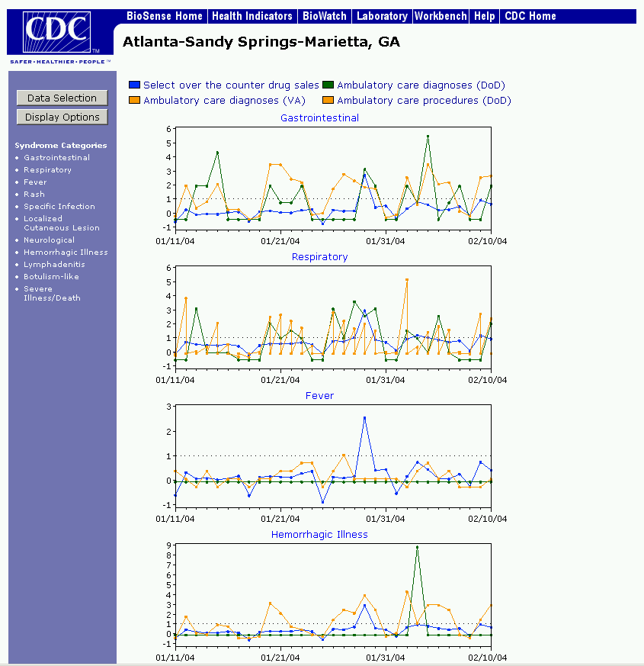
BioSense Health Indicators Page
Syndrome-Specific Maps
Zip Code
“Mouse Over”
Display
Zoom-In/Out
And Map
Navigation
Tool
Data Source
Specific
Maps

Slide 55
MIGRATION
CLUSTERS
VULNERABILITY

Slide 56
Clusters
Rez : >60% of American Indian and Alaska Native Clusters off Reservation
Hoods: African Americans
Towns: Asian Americans
Barrios: Latino Populations
Villages: White clusters

Slide 57
Vulnerability
Caregiver Ratio Index
One was to create an estimate of the number of frail elders—a factor determining the level of care needed. The second variable—the number of potential caregivers—partially defines the level of resources available to meet caregiving needs (Garrett, Baldridge, Benson et al; 2008).

Slide 58
Vulnerability
Nursing Homes
Transportation issues
Multi generational households
Disability
Incarceration
Group Quarters

Slide 59
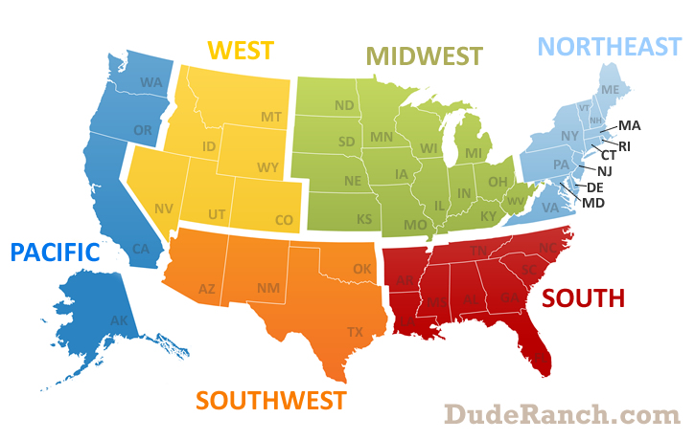
Migration
US Black 1995-2000

Slide 60
Migration
US Latino 1995-2000

Slide 61
Migration
US Asian 1995-2000

Slide 62
Migration
AI/AN 1995-2000

Slide 63
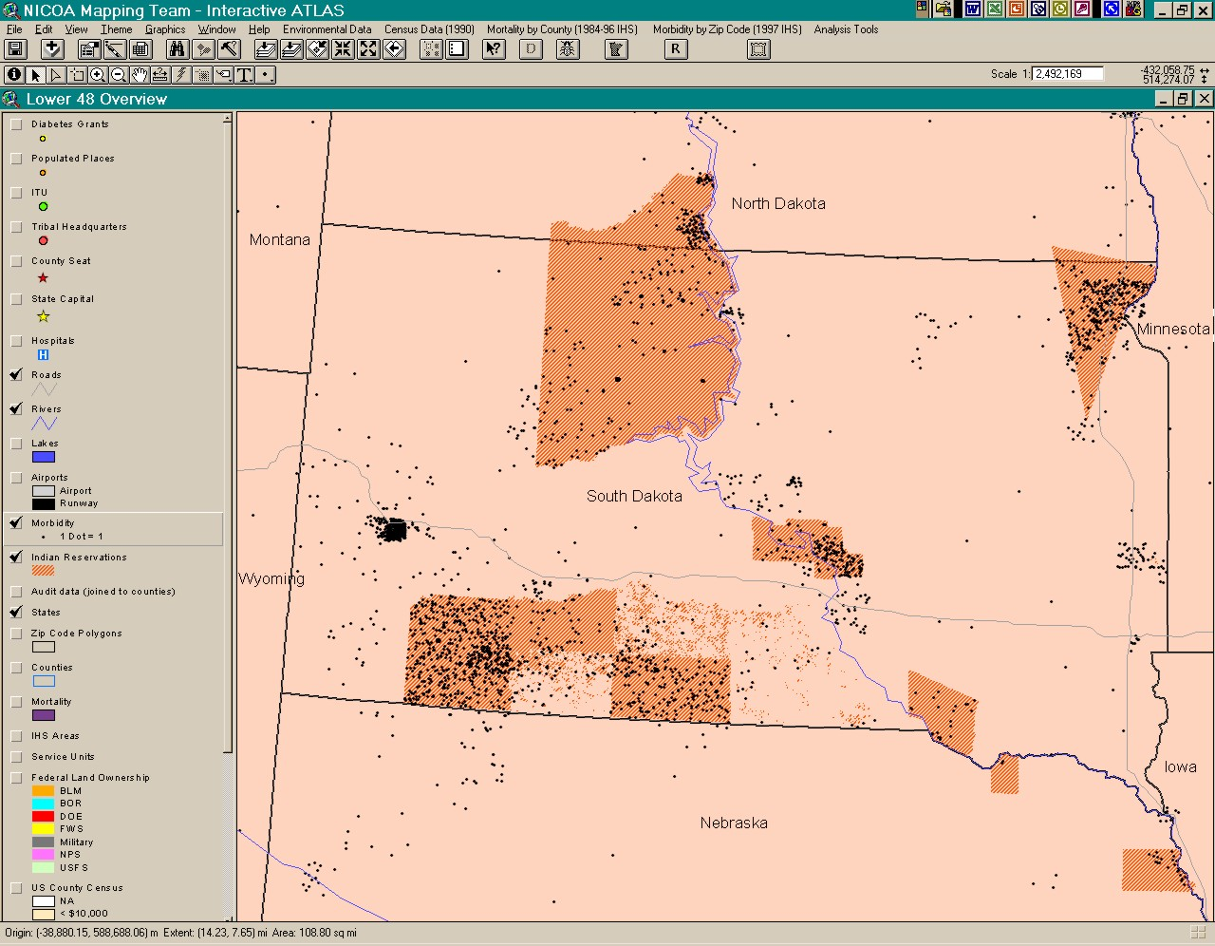
DRAFT

Slide 64
Thank You
Dave Baldridge
  Tel: 505 239 4793
  Email: dave@nipcinfo.com
Mario Garrett
  Tel: 619 992 5317
  Email: mariusgarrett@yahoo.com

