Slide 1
EHR-based Surveillance Learning Community
December 2019 Call
Learning Community Website: www.chronicdisease.org/page/MENDSinfo

Slide 2
Finding your way around Zoom
Meeting controls are at the bottom of the window in the BLACK menu bar
Notes:
Kayla

Slide 3
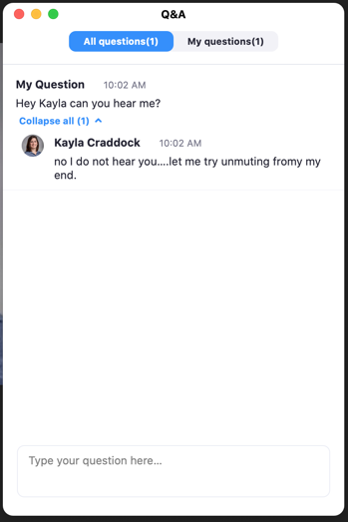
Finding your way around Zoom
Meeting controls are at the bottom of the window in the BLACK menu bar
Notes:
Kayla

Slide 4
Poll Questions
Notes:
Kayla

Slide 5
Today’s Agenda
Introduction to Analysis-Visualization-Reporting
Sara Schmidt and Greg Budney: Colorado Health Observation Regional Data Service (CHORDS) coverage dashboard and maps
Noelle Cocoros: RiskScape visualizations
Facilitated Discussion
Notes:
Kayla

Slide 6
Educational Topic:
Introduction to Analysis-Visualization-Reporting
Notes:
Emily

Slide 7
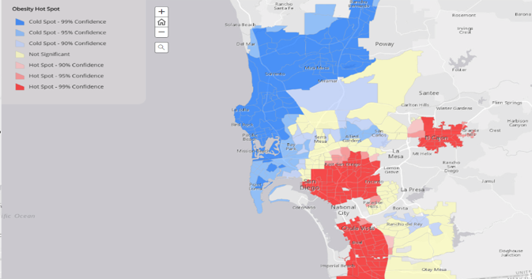
What is Analysis-Visualization-Reporting?
How we manipulate, analyze and display data
Purpose:
Gain deeper insights
Make more informed decisions
Notes:
Level setting on what AVR
Manipulate, analyze, display, share results and interpretations
Lots of interest as all actors in the health ecosystem seek to derive maximum value from digital data

Slide 8
AVR tools
Notes:
AVR is rally about helping us move up this data to information to knowledge to wisdom incline which you’re likely familiar with.
In this way, the overall purpose of AVR is the same as for public health informatics: Both seek to enable more meaningful uses of information to improve practice and ultimately improve population health outcomes.
So AVR tools increase the value of the data we have and enable improved practice.

Slide 9
Analytics vs. Visualization
Data analytics: Methods for examining data, structured or unstructured, to gain new insights and ultimately to take action.
Data visualization: Presenting one or more data sets in visual formats
More immediately understandable and actionable.
Includes dashboards, worksheets, maps
Notes:
Data analytics: Methods for directly examining and manipulating data, structured and unstructured, in order to gain new insights and ultimately to take action.
Data visualization: Presenting one or more data sets in visual formats
More immediately understandable and actionable.
Includes dashboards, worksheets, maps
Business Intelligence (BI) is a related term you see a lot and we need to do more in this area within public health.
Data visualization is an aspect of BI

Slide 10
AVR Tools
COTS, GOTS, and free tools available
Common AVR software tools
Tableau
SAS
Google charts
Fusion Charts
ArcGIS

Slide 11
How to pick?
Stand-alone COTS systems often offer the most features.
But leveraging solutions that can interoperate well with other tools, or for which your agency already has a license, even if not perfect or full-featured, can meet most of your needs at lower cost.
Do your due diligence: Ask for demos based on your use cases, talk to customers, read reviews, etc.
Notes:
Stand-alone commercial-off-the-shelf systems often offer the most features that are regularly updated in new releases. But ongoing licensing costs.
Leveraging solutions that can interoperate well with other tools you already use, or for which your agency already has an enterprise license, even if not perfect or full-featured, can meet most of your needs at lower cost.
Do your due diligence: Ask for demos based on your use cases, talk to customers, read reviews, etc.

Slide 12
Lessons from the Field:
Greg Budney and Sara Schmidt: CHORDS (Colorado) coverage dashboard and maps
Notes:
Greg Budney is an epidemiologist and the Project Manager for Public Health Monitoring for the
Colorado Health Observation Regional Data Service (CHORDS) at Denver Public Health since 2016. Greg
works with local public health agencies that are part of the CHORDS Network to help them understand
and use electronic health record data for population health indicator tracking and analysis.
Sara Schmitt, Managing Director of Research, Evaluation, and Consulting at the Colorado Health
Institute, supports the development and execution of CHI’s research, evaluation, and consulting
portfolios. Sara also leads CHI’s work on the Colorado Health Observation Regional Data Service (CHORDS).
In this role, she facilitates CHORDS governance activities and oversees Network
development and expansion.
Greg – Brief introduction to CHORDS
Sara – CHORDS Coverage and Coverage Visualization
Greg – CHORDS Website, Maps and Web Maps

Slide 13
The Colorado Health Observation Regional Data Service (CHORDS)
Harmonizing Information for a Healthier Colorado
Greg Budney, MPH
Sara Schmitt, MA
Multi-State EHR-Based Network for Disease Surveillance
Learning Community
December 17, 2019

Slide 14
CHORDS 101| What is CHORDS?
SECTION 1

Slide 15
CHORDS is a distributed data network conceived in 2011 that uses electronic health record (EHR) data to support public health evaluation, monitoring and research efforts.
Notes:
SS: CHORDS is a Network – the “who” working together in support of this mission. Allie will share the partners, how they govern themselves and our role.
A technology – the “what”, I will talk about how this happens.
First – work supported currently by a two year grant from CHF to build the who and the what. Second, CHORDS not designed or intended to support direct patient care. It leverages, aggregates data among multiple patients -

Slide 16
CHORDS | What is A Distributed Data Network?
Regional distributed data network
Enables healthcare data to remain in healthcare organizations’ secure environments until particular data are required for a defined public health or research question

Slide 17
CHORDS | A Primer
Data Partners: Twelve health provider organizations
Data Users: Public health agencies serving the seven-county Denver Metro region and three public health agencies serving two northern Colorado counties, and local researchers from a variety of fields
Goal: Expanded use of EHR data to achieve public health and research goals through reliable and location-specific information

Slide 18
CHORDS Network | Who is Involved?
Data Users:
Metro Denver, Larimer* and Weld Counties Public Health Agencies, and CDPHE
Technology Partner:
University of Colorado Anschutz Medical Campus and CORHIO
Convener: CHI
Technology Partner:
CCMCN
Data Partners:
Health Care and Mental Health Care Partners
Notes:
Who are the people and organizations involved in CHORDS? Big picture.
Mention that Larimer County has two public health agencies: Health District of Northern Larimer County and Larimer County Department of Health and Environment

Slide 19
CHORDS Network | Data Partners
Notes:
Narrowing focus down, here are the health care and mental health care centers we have as current or soon to be added partners.
JCMH in progress

Slide 20
CHORDS Data | What’s Included?
Approximately three million patient records
Limited dataset
Geocoded home addresses
CHORDS uses EHR data, accessing clinical information entered by providers

Slide 21
CHORDS Data Model | Available Data
Benefits (e.g., benefit category (e.g., Medicaid, commercial/private))
Diagnoses (e.g., ICD-9/-10 codes)
Encounters (e.g., encounter setting, encounter date)
Laboratory Results (test type, date of test, result – current tests includes Glucose, HgbA1c, Hepatitis C RNA, LDL/HDL, TB)
Linkage (e.g., unique identifier used to de-duplicate across data partners)
Patient Demographics (e.g., age, gender, race, ethnicity)
Patient Reported Outcomes (e.g., PHQ-9, GAD-7, SDOH screening on housing and food insecurity)
Prescribing (e.g. written prescriptions, prescribing physician, quantity, refills)
Procedures (e.g., ICD-9/-10, CPT, HCPCS codes)
Social History (e.g., tobacco, alcohol, and/or drug use)
Vital Signs (e.g. height and weight, diastolic and systolic blood pressure)
Notes:
Here is the current data we ask each site to make available to CHORDS. Again, no direct access to EHR, we pull data into a separate database so it is consistent across sites.

Slide 22
CHORDS Requests | Public Health
Prevalence Data by Demographic and Geographic Filters
BMI Adapter | Liver Health Adapter
Adult BMI | Cirrhosis
Childhood BMI | Hepatitis C RNA Screening
Cancer Adapter | Liver Disease, Cirrhosis and Other Liver Conditions
Breast Cancer | Mental Health Adapter
Colorectal Cancer | Anxiety Disorders
Lung Cancer | Bipolar Disorder
Cardiovascular Disease Adapter | Depression
Acute Myocardial Infarction | Depression during Pregnancy
Atrial Fibrillation | Musculoskeletal Adapter
Heart Failure | Hip/Pelvic Fracture
Hyperlipidemia | Osteoporosis
Hypertension | Rheumatoid Arthritis/Osteoarthritis
Ischemic Heart Disease | Respiratory Disease Adapter
Cognitive Health Adapter | Asthma
Alzheimer's Disease | Substance Use Adapter
Alzheimer's Disease, Related Disorders or Senile Dementia | Alcohol Use Disorders
Diabetes Adapter | Cannabis Abuse and Dependence
Diabetes Control among Adults with Type 2 Diabetes | Cannabis Poisoning and Adverse Effects
Pre-Diabetes | Cannabis Use
Type 1 Diabetes | Drug Use Disorders
Type 2 Diabetes | Opioid Use Disorder
Type 1, Type 2 and other Diabetes-Related Conditions | Tobacco Use Adapter
Disabilities Adapter | Tobacco Use
Mobility Impairments
Notes:
Most of these case definitions come from the CMS Chronic Conditions Warehouse. Others come from other resources (i.e., for diabetes control levels we used ADA resources to determine A1c test result categories; other case definitions comes from working with subject matter experts)

Slide 23
CHORDS Requests | Public Health Use Case Examples
Notes:
We’ve also had requests for presentations with the Mayor, grant applications, community health assessments and other similar projects. We’ve also worked with community based organizations to get them data for their work (e.g., Rose Community Foundation’s Latino Age Wave)

Slide 24
CHORDS Requests | Research
Research Topics
Childhood Obesity
Childhood Obesity Data Initiative
Diabetes
SEARCH for Diabetes in Youth
Pregnancy-Related
Long-Acting Reversible Contraceptives and Adolescent Pregnancy
Long-Acting Reversible Contraceptives and Sexually Transmitted Infections
Respiratory Disease
Asthma Exacerbation Index
Asthma and Airborne Exposures
Opioid Prescriptions
Opioid Tapering
Spinal Fusion Procedures and Prescribed Opioids
Notes:
Researchers have presented at conferences (i.e., presentations and posters), some have been featured in news articles

Slide 25
CHORDS Visualization| Coverage Dashboard
SECTION 2

Slide 26
Surveillance System Representativeness
Surveillance systems should be representative
Demographics: age, sex, race, ethnicity
Geography: county, census tract
CHORDS includes a subset of individuals who sought health care at particular organizations
Calculating coverage helps inform the representativeness of the CHORDS population
We can generalize to different populations:
General population (e.g., US Census)
Care-seeking population (e.g., BRFSS)

Slide 27
CHORDS Coverage Dashboard: Current

Slide 28
CHORDS Coverage Dashboard: Future

Slide 29
CHORDS Visualization| Data-Centric, Public-Facing Website

Slide 30
CHORDS Website Deliverable
CHORDS Funding
Year Three Goal
CDPHE’s Center for Health and Environmental Data will provide geographic visualization and web-based display of aggregate data sets.
Hosted on CDPHE’s website
Map PDF is available for download
Underlying data/results document not downloadable

Slide 31
CHORDS Website Development Timeline
CHORDS Website Development Timeline (Major Milestones)
2017
December: Draft proposal presented to CHORDS Governance Committee
2018
January: Work group meets to identify methods, layout, text, etc.
March: Final proposal presented to CHORDS Governance Committee
June: Data requests submitted
July: Data sent to CDPHE for processing
August - October: Draft PDF maps distributed to CHORDS Network for feedback
October: Final PDF maps approved
October - November: Draft web maps distributed to CHORDS Network for feedback
November: Final web maps approved
December: Final website package approved by CHORDS Governance Committee
2019
January - February: Website usability testing completed
April: Soft launch of website
May - June: Local public health agency email blasts to stakeholders announcing website
September: Maps updated

Slide 32
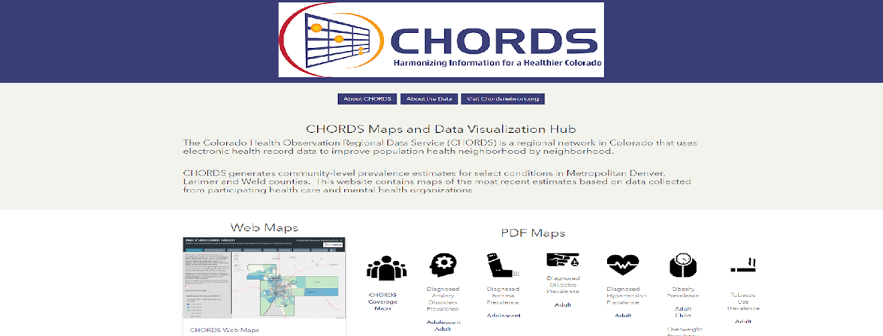
CHORDS Landing Page
https://chordsmaps-cdphe.opendata.arcgis.com/
Notes:
This shows the link to the landing page as well as a screenshot of the landing page.

Slide 33
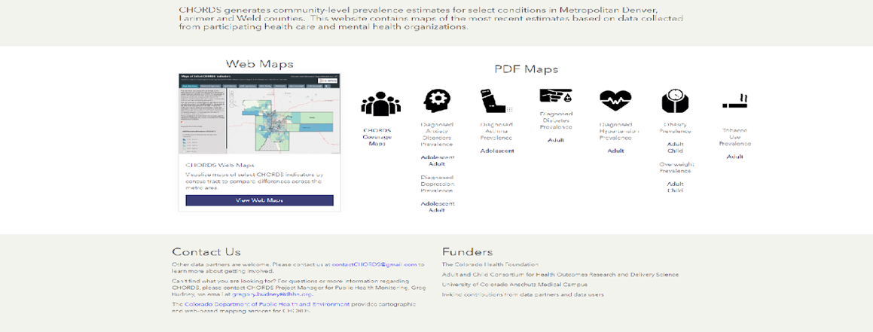
CHORDS Landing Page
Notes:
This is a screenshot of the landing page.

Slide 34
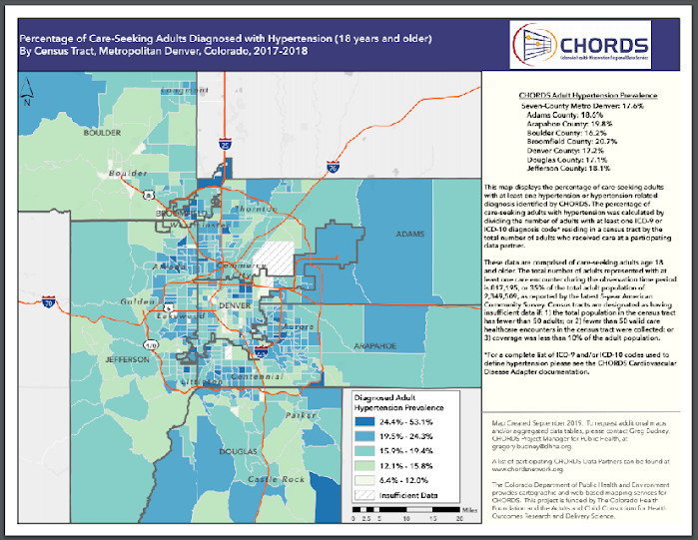
CHORDS PDF Maps
Notes:
This is a screenshot of the seven-county Metro Denver area PDF for adult diagnosed hypertension.

Slide 35
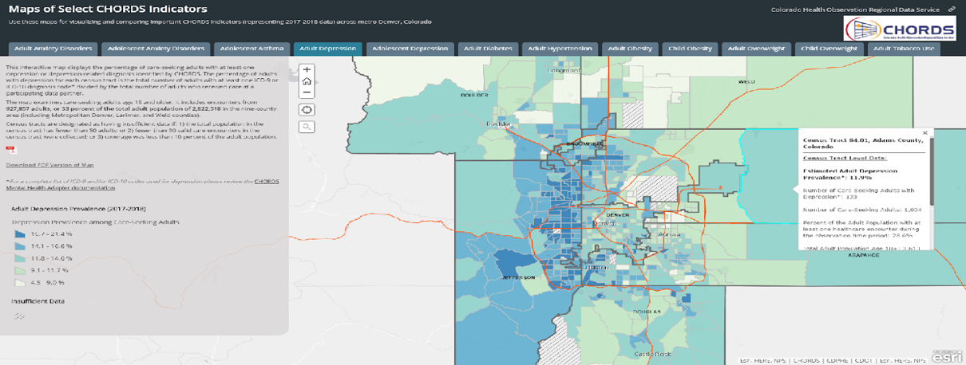
CHORDS Interactive Web Maps
Notes:
This is a screenshot of the interactive web map with one of the census tracts selected.

Slide 36
Questions?
Greg Budney, MPH
Epidemiologist/CHORDS Project Manager
Denver Public Health
gregory.budney@dhha.org
Sara Schmitt, MA
Managing Director, Research, Evaluation and Consulting
Colorado Health Institute
schmitts@coloradohealthinstitute.org

Slide 37
Lessons from the Field:
Noelle Cocoros: RiskScape visualizations

Slide 38
Using Electronic Health Care Data for Population Health Surveillance
RiskScape
December 17, 2019
Noelle M. Cocoros, DSc, MPH
Department of Population Medicine
Harvard Medical School and Harvard Pilgrim Health Care Institute

Slide 39
Electronic Support for Public Health (ESP)
Electronic medical record Support for Public Health
Software and architecture to extract, analyze, and transmit electronic health information from providers to public health.
Surveys codified electronic health record data for patients with conditions of public health interest
Generates secure electronic reports for the state health department
Designed to be compatible with any EHR system
JAMIA 2009;16:18-24 MMWR 2008;57:372-375
Am J Public Health 2012;102:S325–S332 Am J Public Health 2014;104:2265-2270 Am J Public Health 2017;107:1406-1412
Notes:
39

Slide 40
esphealth.org
Open source
Free to download

Slide 41
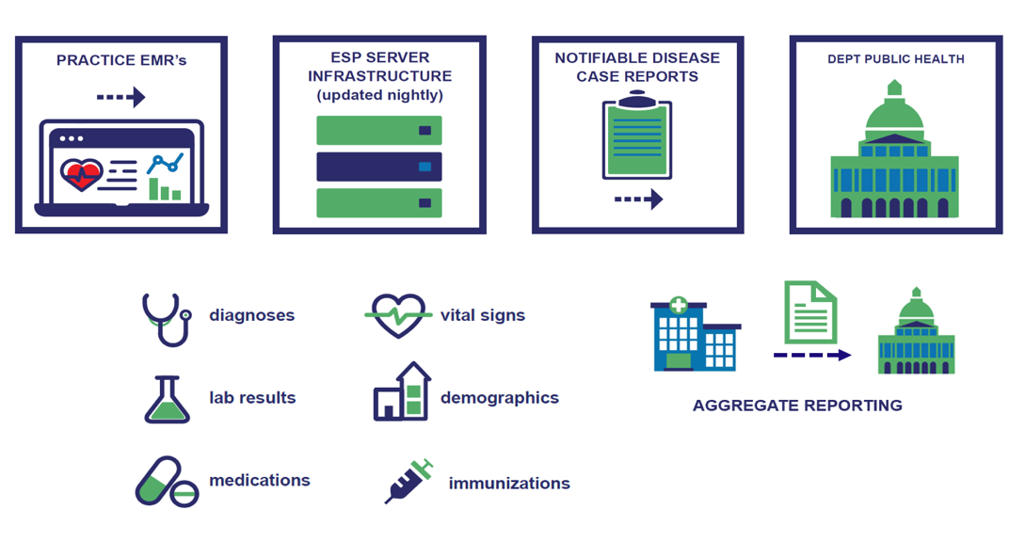

Slide 42
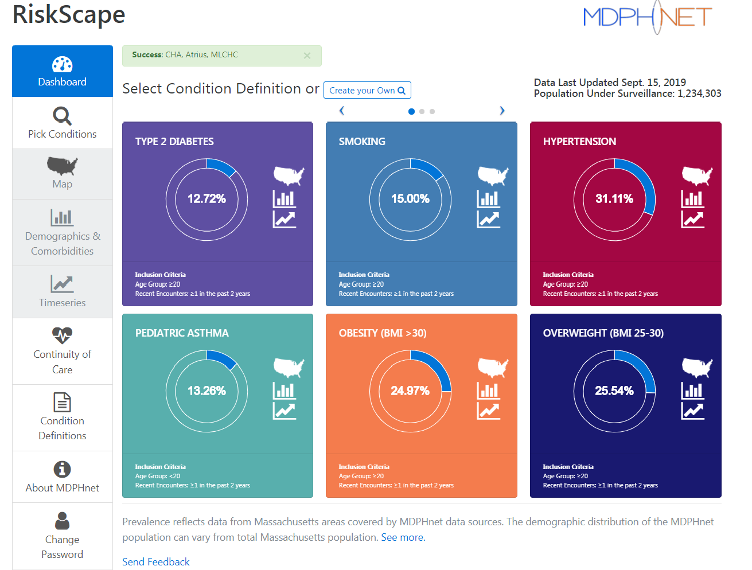

Slide 43
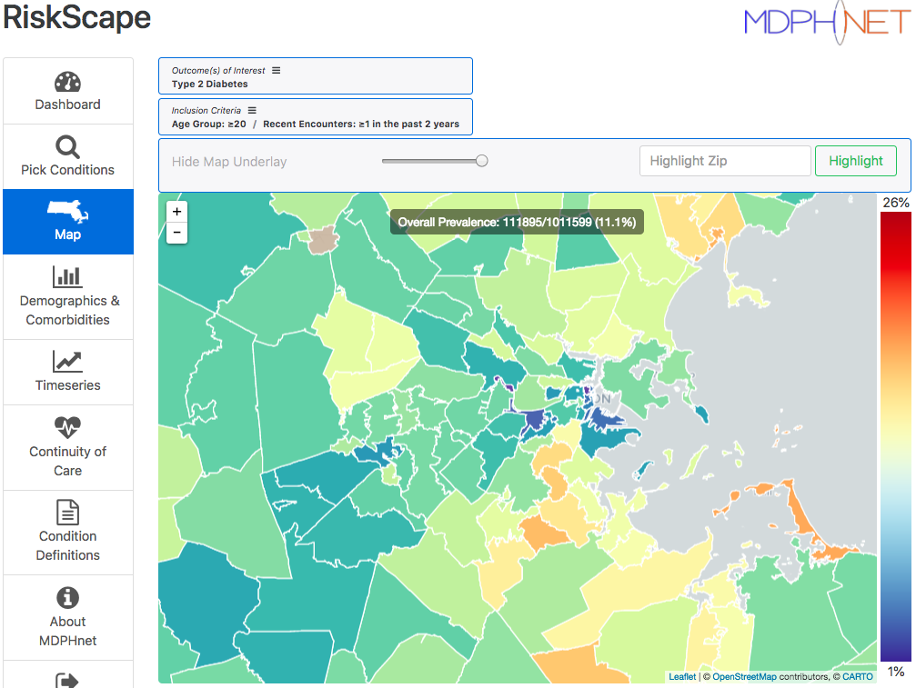
Type 2 Diabetes in Adults

Slide 44
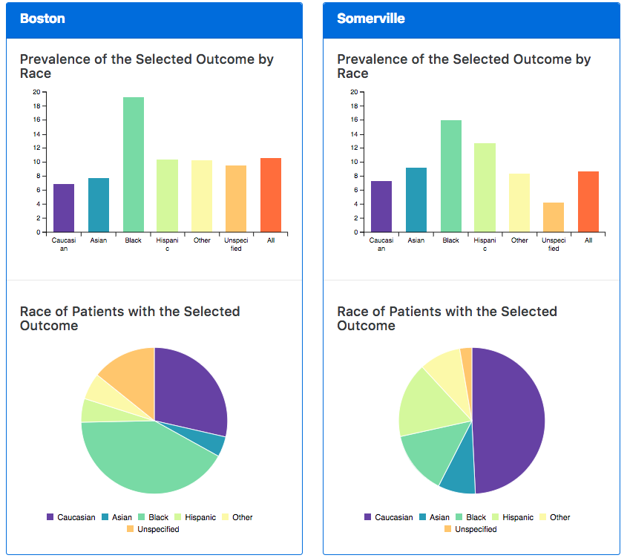

Slide 45
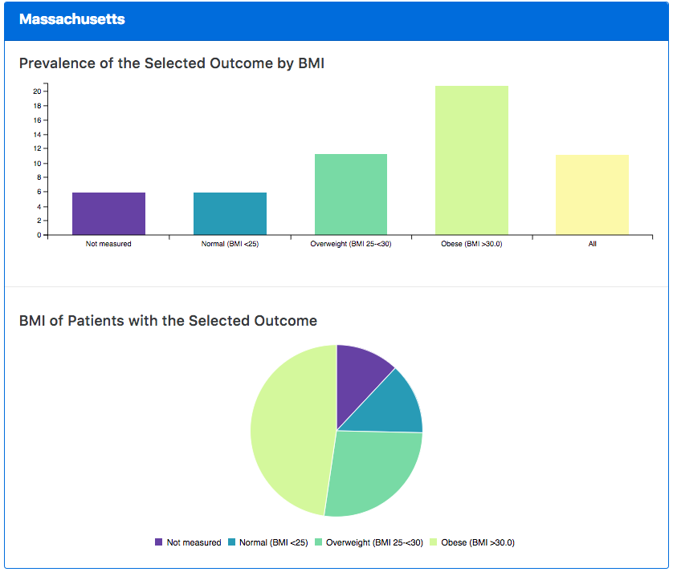
Type 2 Diabetes in Adults Stratified by BMI

Slide 46
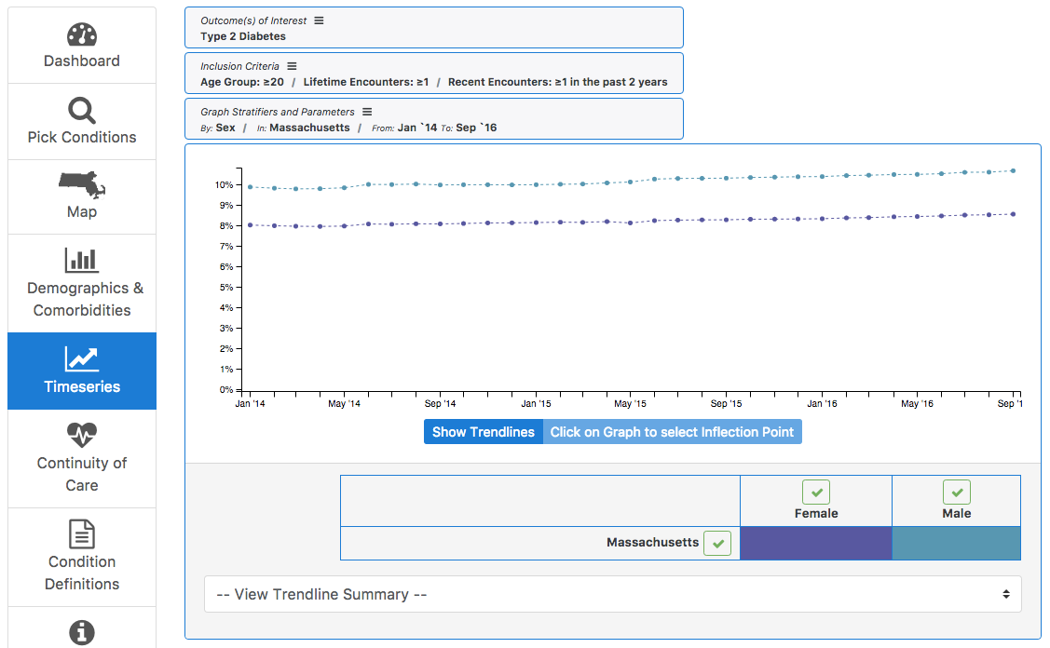
Type 2 Diabetes in Adults

Slide 47
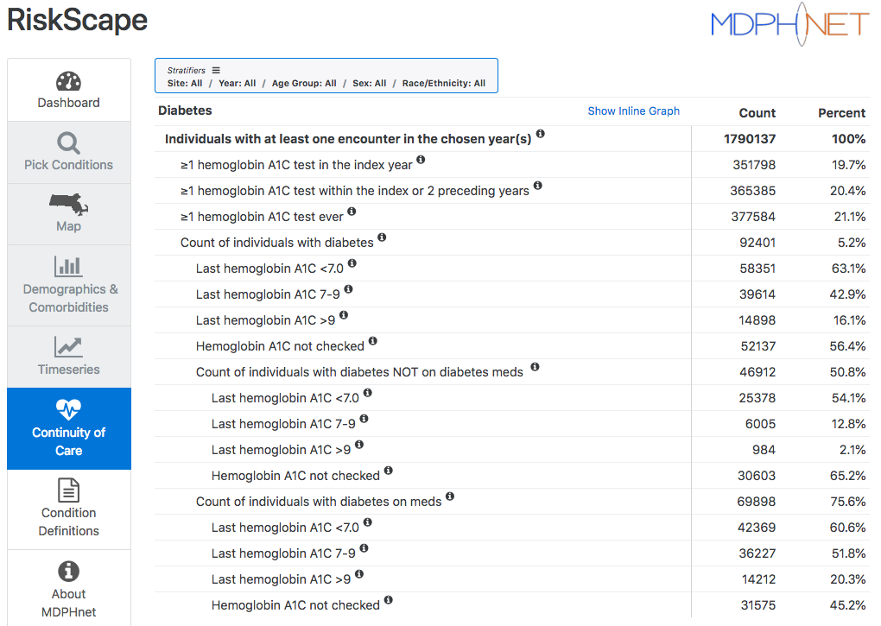
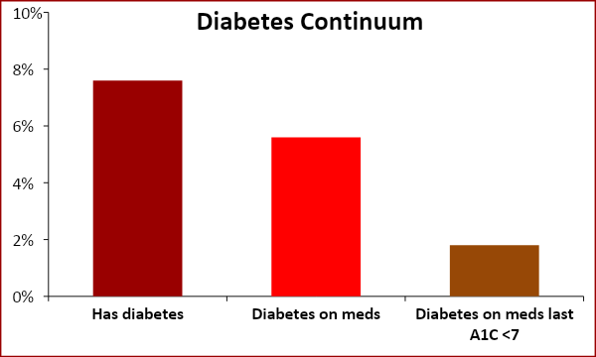
Diabetes Continuum of Care

Slide 48
QUESTIONS?
noelle_cocoros@harvardpilgrim.org

Slide 49
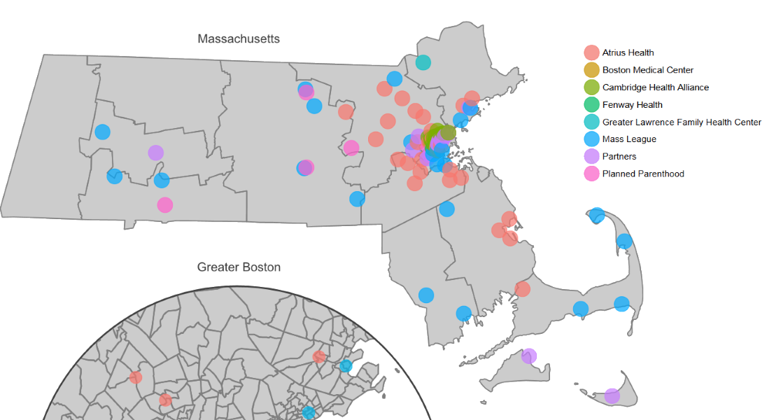
Current ESP Installations

Slide 50
Discussion Questions
Notes:
You’ve been doing a lot of listening. Now is the time to participate more actively.
Emilie: Raise hand to unmute or write in chat

Slide 51
Announcement
Journal Club session:
Application of Geographic Information Systems to Address Chronic Disease Priorities: Experiences in State and Local Health Departments
Thursday, Dec. 19, 3-3:30 p.m. ET
Notes:
Check this Monday’s OTC. No registration required.

Slide 52
Housekeeping
Next meeting: January 21 at 3pm EST
Educational Topics include:
State of EHRs and HIEs today
Pros and Cons of EHR data for surveillance and other public health purposes
PLEASE COMPLETE THE POST WEBINAR SURVEY!

